Slide 1
Emerging Technologies for the Circular Economy
Lecture 10: Ethereum and Smart Contracts
Prof. Dr. Benjamin Leiding (Clausthal)
Dr. Arne Bochem (Göttingen)
M.Sc. Anant Sujatanagarjuna (Clausthal)
M.Sc. Shohreh Kia (Clausthal)
Notes:
<number>

Slide 2
License
This work is licensed under a Creative Commons Attribution-ShareAlike 4.0 International License. To view a copy of this license, please refer to https://creativecommons.org/licenses/by-sa/4.0/ .
Updated versions of these slides will be available in our Github repository.

Slide 3
Disclaimer and Further Resources
The lecture slides (Figures are often copied directly) are based on the course Blockchain-based Systems Engineering from TU Munich, which is distributed under a CC-BY-SA 4.0 license
All their slides, exercises and further information are available online: https://github.com/sebischair/bbse

Slide 4
Introduction to Ethereum

Slide 5
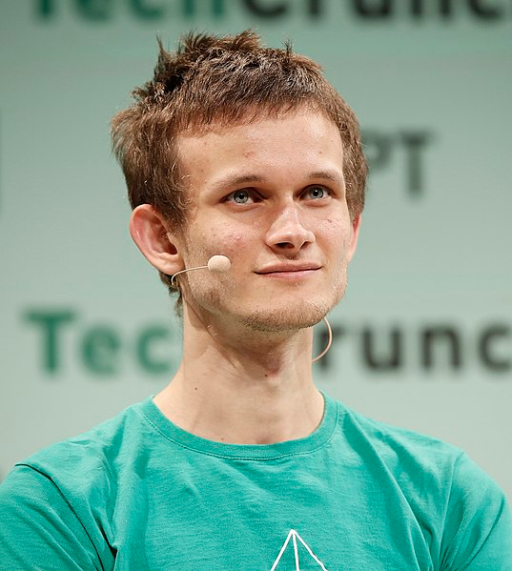
History
Publicly announced in January 2014 by Vitalik Buterin
Public crowd sale in July 2014
60 million Ether sold for 31,591 Bitcoin
Worth around 18.5 million USD at that time
Funds controlled by the Ethereum foundation
“Founder of Ethereum Vitalik Buterin during TechCrunch Disrupt London 2015 - Day 2 at Copper Box Arena on December 8, 2015 in London, England.” by John philps is licensed under CC BY 2.0.
History of Ethereum: http://ethdocs.org/en/latest/introduction/history-of-ethereum.html

Slide 6
Ethereum Foundation
“The Ethereum Foundation’s mission is to promote and
support Ethereum platform and base layer research,
development and education to bring decentralized
protocols and tools to the world that empower developers to
produce next generation decentralized applications
(dApps), and together build a more globally accessible, more
free and more trustworthy Internet.”

Slide 7
Ethereum Foundation
Founded in June 2014 in Zug, Switzerland
Non-profit organization
Foundation council consists of Vitalik Buterin and Patrick Storchenegger (legal affairs)
Owns (or owned) at least 31,591 Bitcoins funding capital from the initial crowd sale

Slide 8
Ethereum White Paper
First draft was written by Vitalik Buterin himself (2013)
Contains high-level descriptions of Ethereum’s core functionalities
Living document and regularly updated by Ethereum core developers
Extensive summary of the Ethereum platform and technology
Most current version is available via the public Git-repository: Link

Slide 9
Ethereum Yellow Paper
Published in April 2014 by Dr. Gavin Wood
Dr. Gavin Wood is still listed as the only author
Defines the technical specification of Ethereum
Very detailed, contains mathematical function definitions and byte code mappings
Required to implement a full node
Only updated when errors are found or the specification changes
Yellow Paper

Slide 10
Ethereum System Architecture

Slide 11
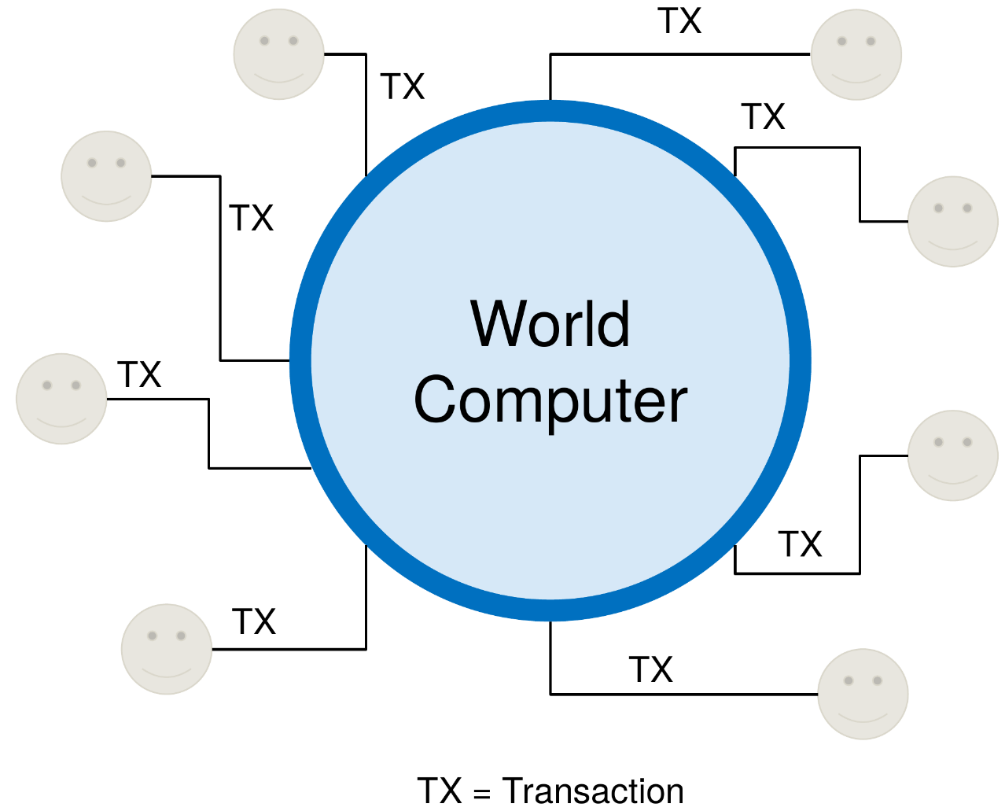
The Concept of a World Computer
All participants are using the same computer
Users issue transactions to call programs on
the computer
Everyone shares the same resources and storage
The computer has no explicit, single owner
Using the computer’s resources costs money
U. Gallersdörfer, P. Holl, and F. Matthes, “Blockchain-based Systems Engineering – Lecture Slides,” Oct 2019. [Online]. Available: https://github.com/sebischair/bbse

Slide 12
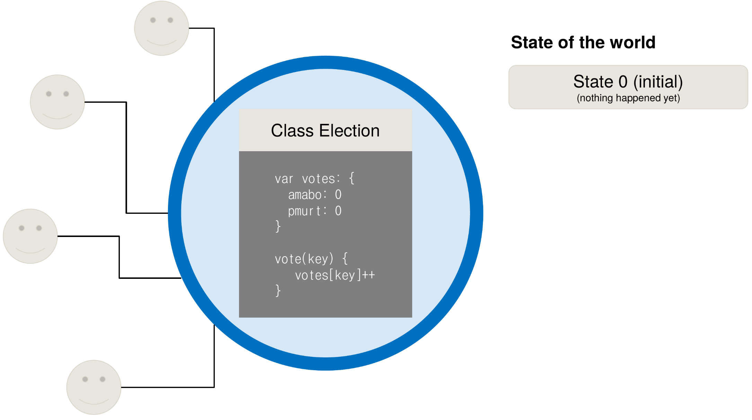
Elections using a World Computer
U. Gallersdörfer, P. Holl, and F. Matthes, “Blockchain-based Systems Engineering – Lecture Slides,” Oct 2019. [Online]. Available: https://github.com/sebischair/bbse

Slide 13
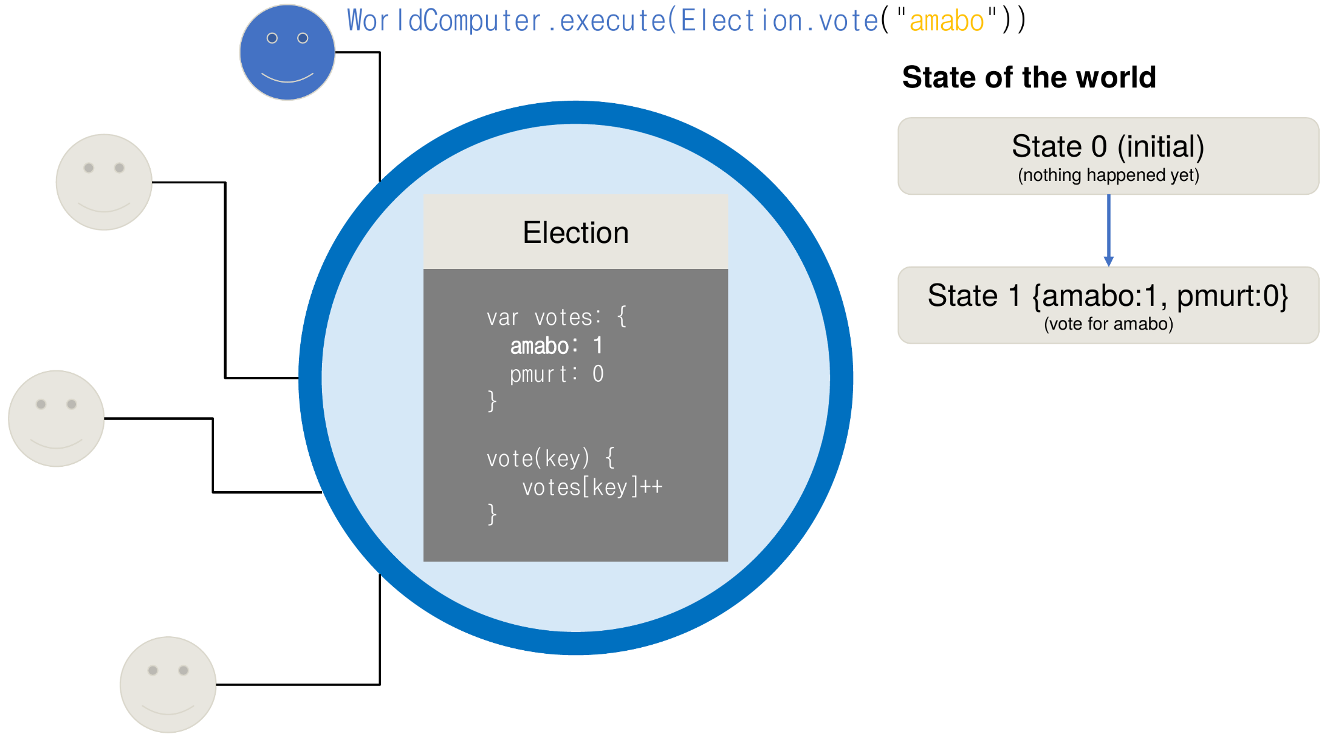
Elections using a World Computer
U. Gallersdörfer, P. Holl, and F. Matthes, “Blockchain-based Systems Engineering – Lecture Slides,” Oct 2019. [Online]. Available: https://github.com/sebischair/bbse

Slide 14
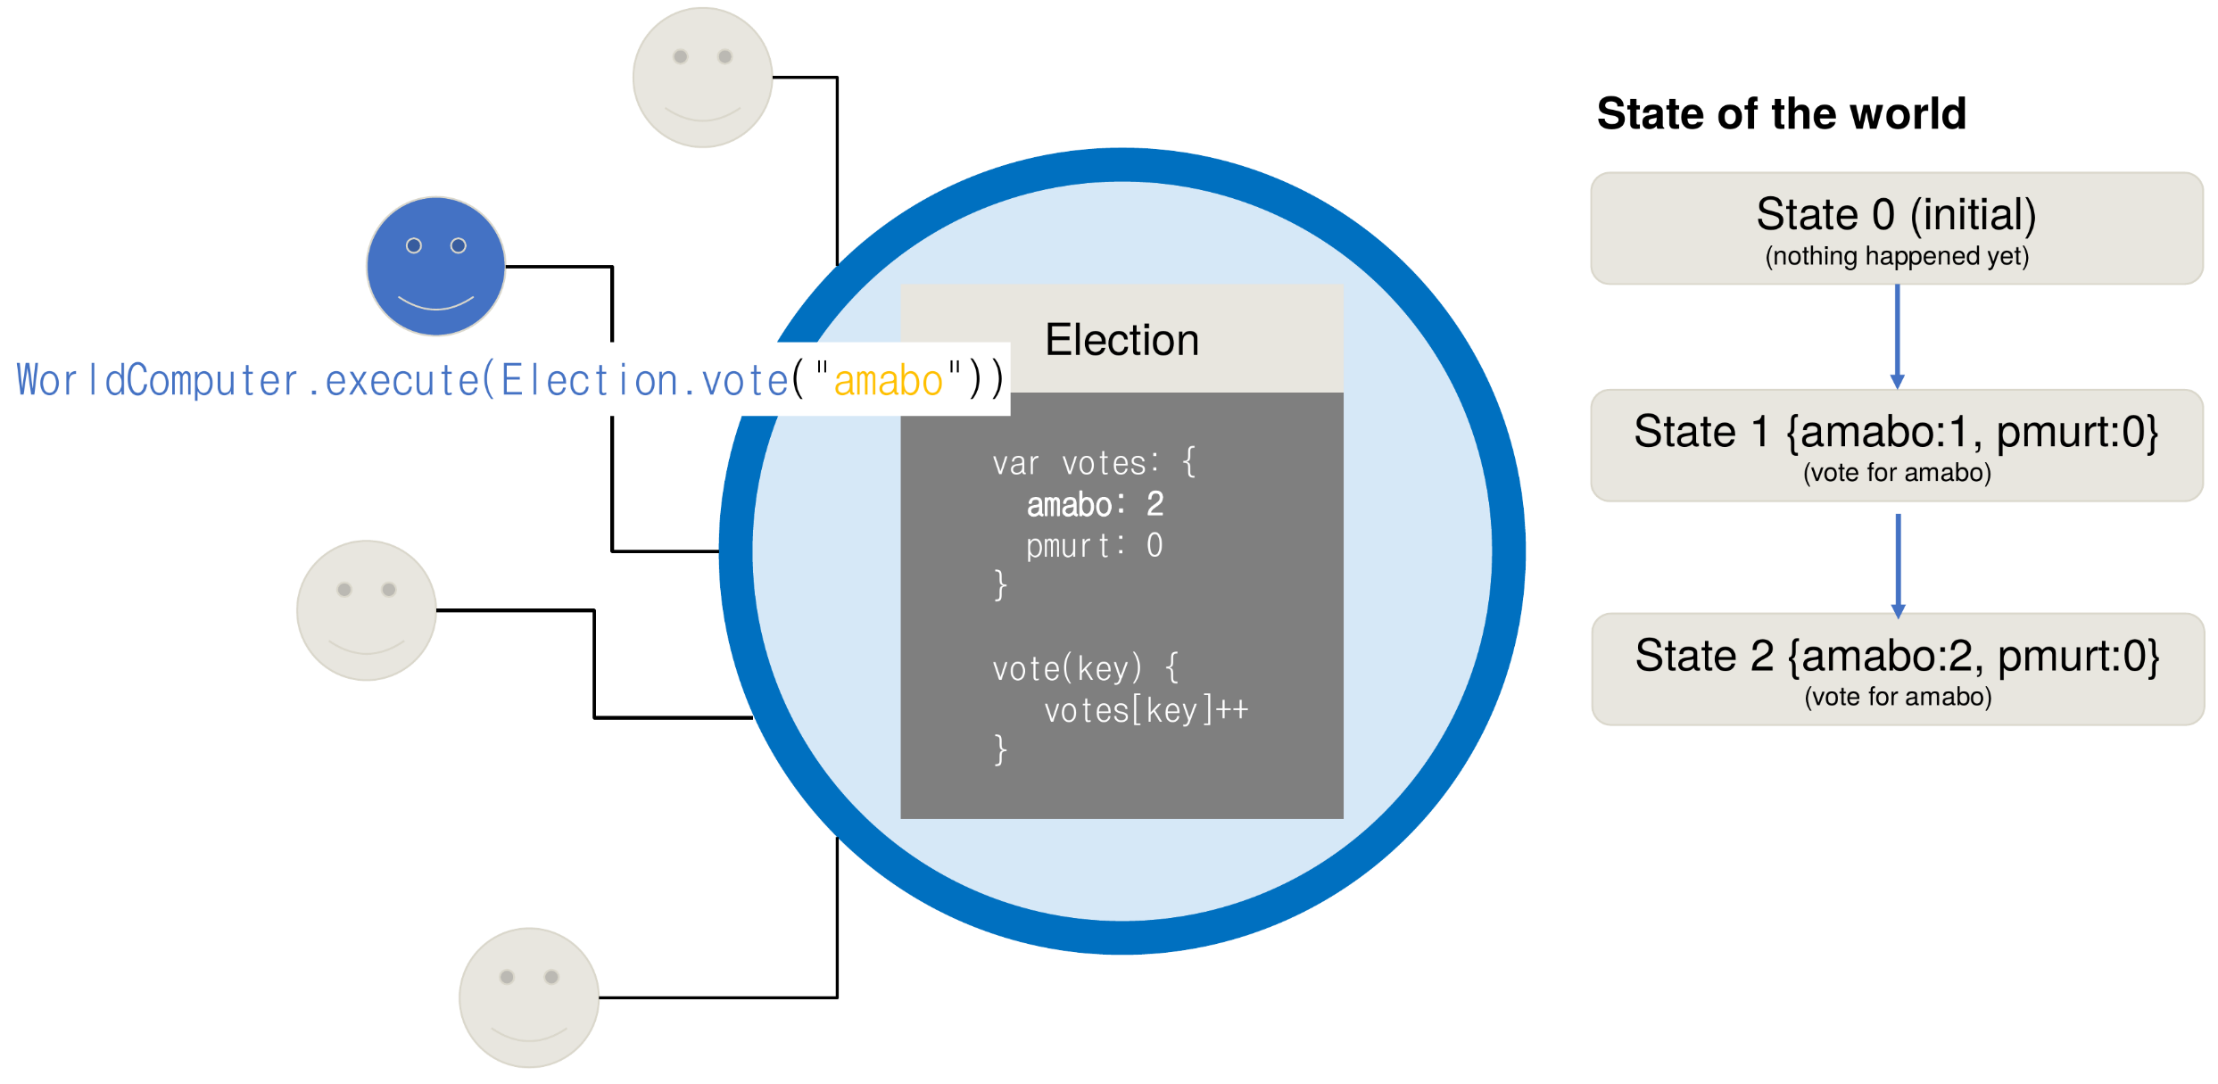
Elections using a World Computer
U. Gallersdörfer, P. Holl, and F. Matthes, “Blockchain-based Systems Engineering – Lecture Slides,” Oct 2019. [Online]. Available: https://github.com/sebischair/bbse

Slide 15
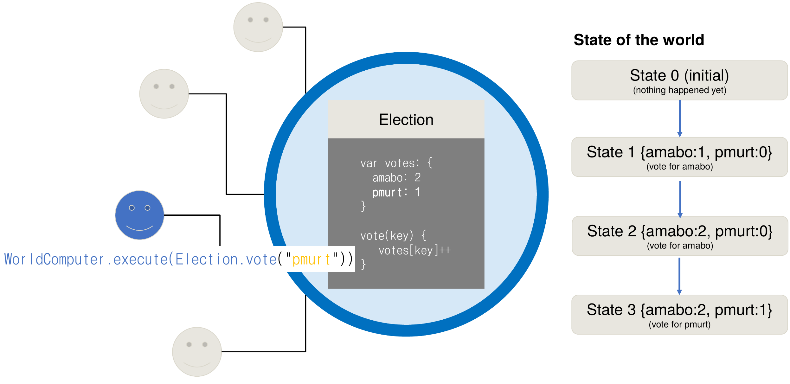
Elections using a World Computer
U. Gallersdörfer, P. Holl, and F. Matthes, “Blockchain-based Systems Engineering – Lecture Slides,” Oct 2019. [Online]. Available: https://github.com/sebischair/bbse

Slide 16
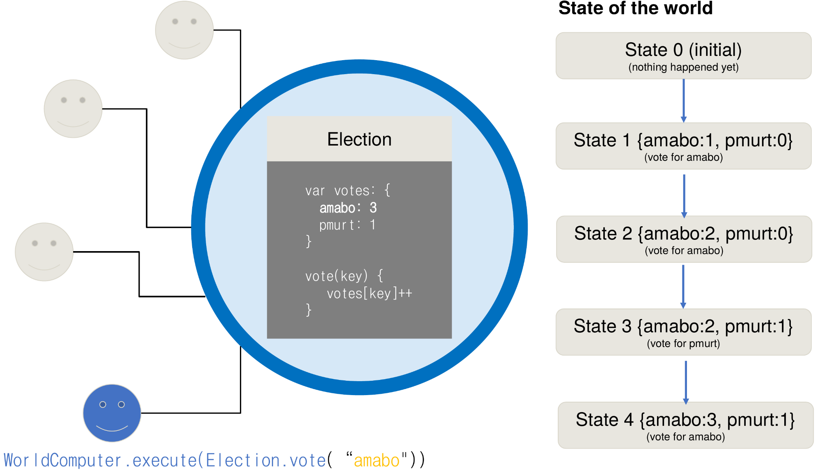
Elections using a World Computer
U. Gallersdörfer, P. Holl, and F. Matthes, “Blockchain-based Systems Engineering – Lecture Slides,” Oct 2019. [Online]. Available: https://github.com/sebischair/bbse

Slide 17
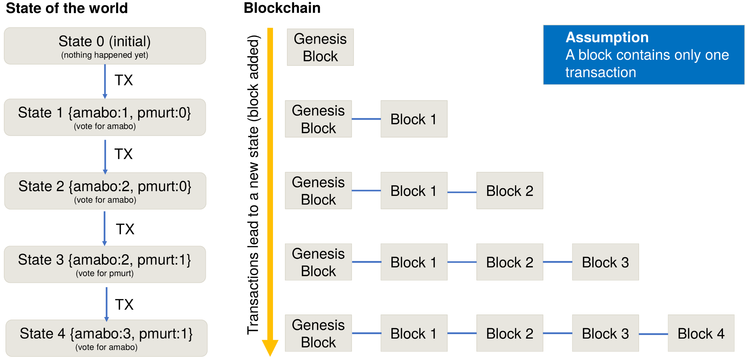
The Blockchain State Machine
U. Gallersdörfer, P. Holl, and F. Matthes, “Blockchain-based Systems Engineering – Lecture Slides,” Oct 2019. [Online]. Available: https://github.com/sebischair/bbse

Slide 18
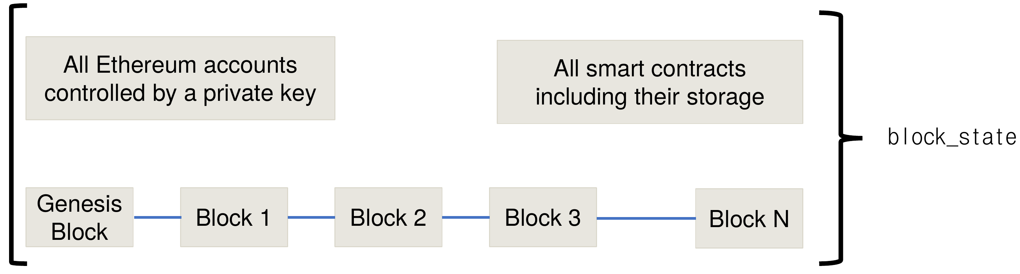
The Concept of a State Machine
The EVM specifies an execution model for state changes of the blockchain
Formally, the EVM can be specified by the following tuple: (block state, transaction, message, code, memory, stack, pc, gas)
The block state represents the global state of the whole blockchain including all accounts, contracts and storage
U. Gallersdörfer, P. Holl, and F. Matthes, “Blockchain-based Systems Engineering – Lecture Slides,” Oct 2019. [Online]. Available: https://github.com/sebischair/bbse

Slide 19
Transaction
A transaction is a signed data package that is always sent by a wallet and contains the following data:
Recipient
Sender’s signature
Amount of ETH to transfer
Optional data field
A STARTGAS value, representing the maximum number of computational steps the transaction execution is allowed to take
A GASPRICE value, representing the fee the sender pays per computational step

Slide 20
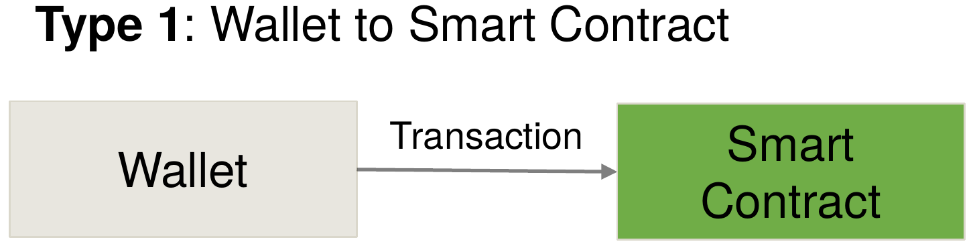
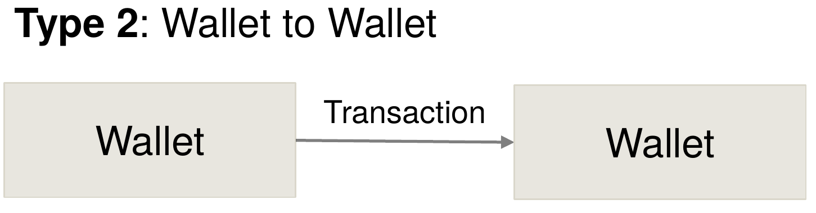
Transactions
There are two types of transactions:
U. Gallersdörfer, P. Holl, and F. Matthes, “Blockchain-based Systems Engineering – Lecture Slides,” Oct 2019. [Online]. Available: https://github.com/sebischair/bbse

Slide 21
Messages
Similar to a transaction, but only sent by contracts and exist only virtually, i.e. they are not mined into a block like transactions
Message contains:
Sender of the message (implicit)
Recipient
Amount of ETH to be transferred
Optional data field
STARTGAS value

Slide 22

Messages
Whenever a contract calls a method on another contract, a virtual message is sent.
Whenever a wallet calls a method on a contract, a transaction is sent.
U. Gallersdörfer, P. Holl, and F. Matthes, “Blockchain-based Systems Engineering – Lecture Slides,” Oct 2019. [Online]. Available: https://github.com/sebischair/bbse

Slide 23
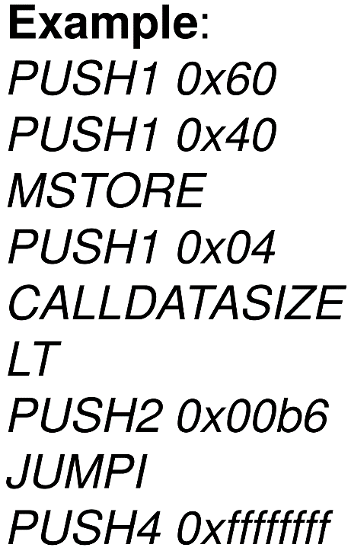
Code and Memory
Code:
Bytecode representation of a smart contract. EVM interprets smart contracts as a sequence of opcodes similar to assembly code.
U. Gallersdörfer, P. Holl, and F. Matthes, “Blockchain-based Systems Engineering – Lecture Slides,” Oct 2019. [Online]. Available: https://github.com/sebischair/bbse

Slide 24
Code and Memory
Code:
Bytecode representation of a smart contract. EVM interprets smart contracts as a sequence of opcodes similar to assembly code.
Memory:
An infinitely expandable byte array that is non-persistent and used as temporal storage during execution.
U. Gallersdörfer, P. Holl, and F. Matthes, “Blockchain-based Systems Engineering – Lecture Slides,” Oct 2019. [Online]. Available: https://github.com/sebischair/bbse
ETCE – (TU Clausthal / University of Göttingen)
ETCE – (TU Clausthal / University of Göttingen)

Slide 25
Stack and Program Counter
Stack:
The stack is also used as a fast, non-persistent buffer to which 32 byte values can be pushed and popped during execution.
PC:
Stands for “program counter”.
The program counter is always initialized with 0 and points to the position of the current opcode instruction.

Slide 26
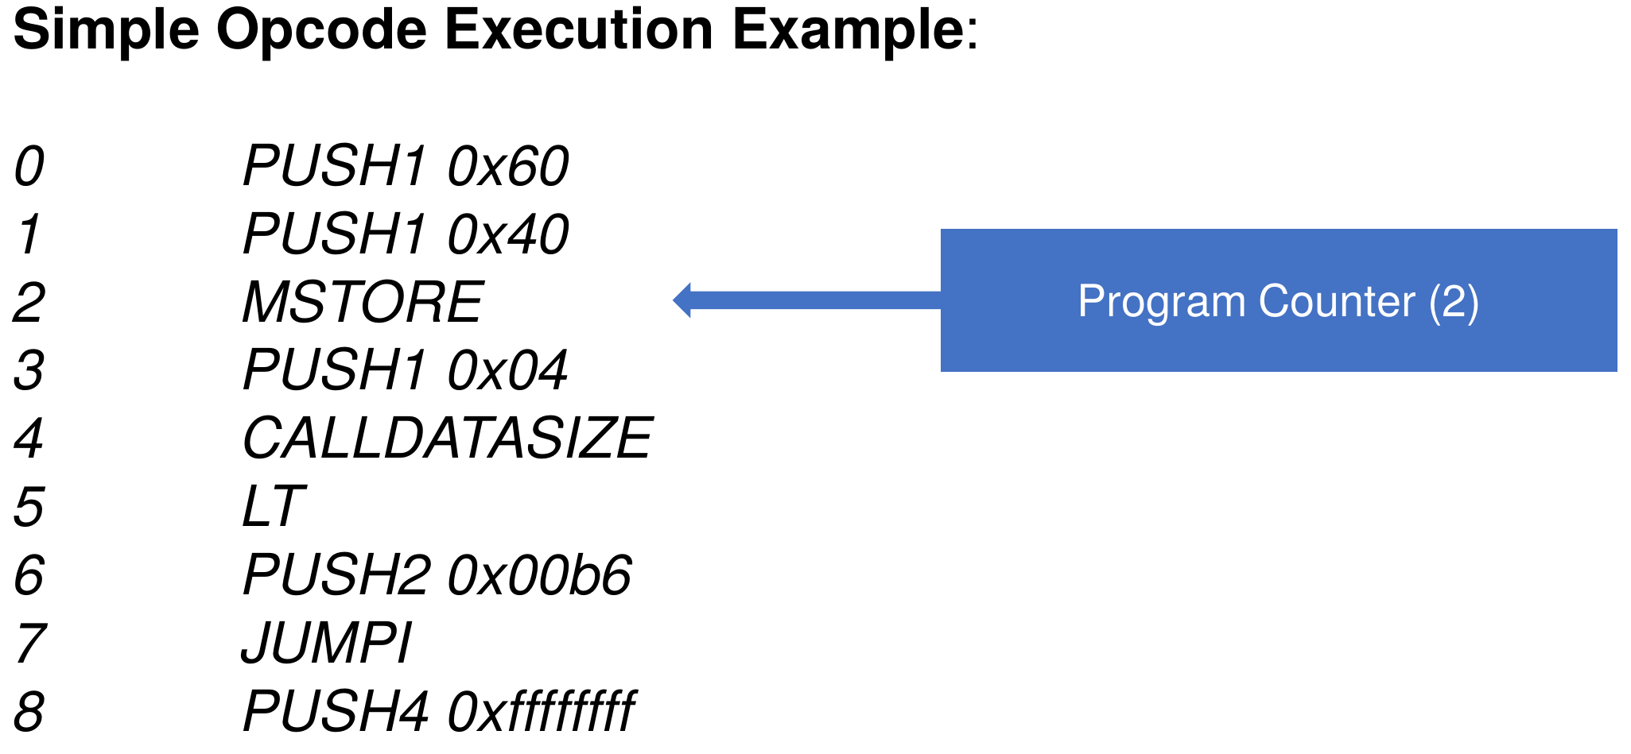
Stack and Program Counter
U. Gallersdörfer, P. Holl, and F. Matthes, “Blockchain-based Systems Engineering – Lecture Slides,” Oct 2019. [Online]. Available: https://github.com/sebischair/bbse

Slide 27
Gas
Executed opcode instruction use miner’s computational resources → requires a fee (called gas)
Each opcode uses a certain amount of gas which may depend on the arguments of the operation
Opcode for self-destruct(address) uses negative gas because it frees up space from the blockchain
Sender must specify maximum amount of gas that he/she/it is willing to pay for the transaction
Sender can set an arbitrary amount of Ether to be spent → called gas price
Final costs for transaction → gas × gasprice
If a transaction requires more gas as the maximum specified gas, the transaction fails
If it takes less, the sender only pays the gas that was used

Slide 28
Account Types
Ethereum uses an account-based ledger → Each distinct address represents a separate, unique account.
Accounts controlled by private keys and owned externally
Can sign transactions, issue smart contract functions calls and send Ether from one account to another
Origin of any transaction is always an account controlled by a private key
Smart contract accounts controlled by their code
Smart Contracts are treated as account entities with their own, unique address
Can send messages to other accounts, both externally controlled and smart contracts
Can’t issue a transaction themselves.
Have a persistent internal storage to write and read data from

Slide 29
Account Properties
Ethereum account is a 4-tuple containing: (nonce, balance, contract code, storage)
Nonce:
Increasing number that is attached to any transaction to prevent replay attacks and double spending.
Balance:
Current account balance in ETH.
Contract code:
Bytecode representation of the account. If no contract code is present, then the account is externally controlled.
Storage:
Data storage used by the account – empty by default.
Only contract accounts can have their own storage.

Slide 30
Ethereum Network Architecture

Slide 31
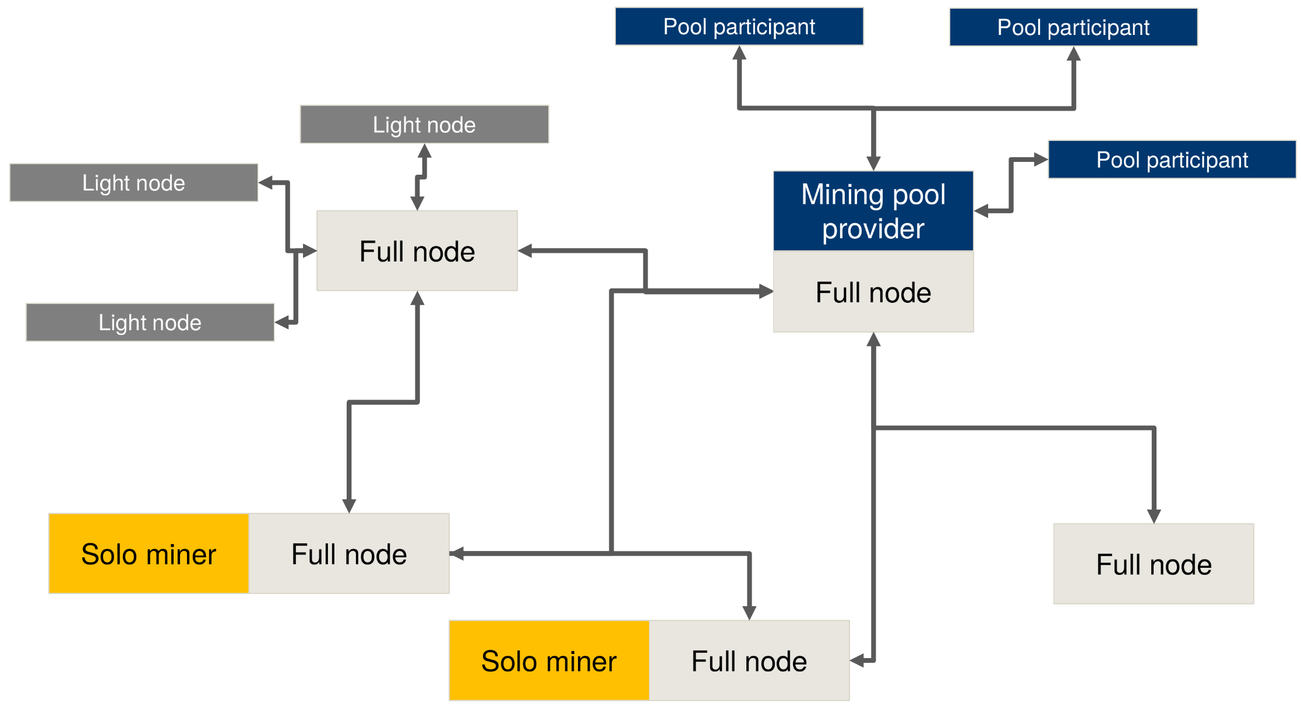
Network Architecture Overview
U. Gallersdörfer, P. Holl, and F. Matthes, “Blockchain-based Systems Engineering – Lecture Slides,” Oct 2019. [Online]. Available: https://github.com/sebischair/bbse

Slide 32
Node Types
Full nodes:
Holds complete copy of the entire blockchain
P2P synchronization with other full nodes
Transactions must be sent to a full node to join the transaction pool
Light nodes:
Clients connected to full nodes → instead of downloading the full blockchain on its own
Most commonly used by private users
Solo miner:
An entity that tries to mine a block on its own
Staking/Mining pools:
Coalition of entities combining their hash power / staking power
Revenue/Reward is shared among participants

Slide 33
Ethereum Smart Contracts

Slide 34
What is a Smart Contract?
A contract is a legal document
that binds two or more parties
who agree to execute a transaction immediately or in the future
Smart contracts are digitization of legal contracts
In Ethereum,
smart contracts are deployed, stored and executed within the Ethereum Virtual machine (EVM)
https://medium.com/coinmonks/https-medium-com-ritesh-modi-solidity-chapter1-63dfaff08a11

Slide 35
What is a Smart Contract?
Also known as self executing contract or digital contracts
It is like a vending machine, i.e. the ledger → You put money/data and you expect a finite item (e.g. your license, .. )
Vitalik Buterin’s explanation:
An asset or currency is transferred into a program,
the program runs this code and at some point it automatically validates a condition
and it automatically determines whether the asset should go to one person or back to the other person,
or whether it should be immediately refunded to the person who sent it or some combination thereof.
In the meantime, the decentralized ledger also stores and replicates the document which gives it a certain security and immutability.
https://blockgeeks.com/guides/smart-contracts/

Slide 36
Smart Contract – Rent an Apartment
You get a receipt which is held in our virtual contract;
I give you the digital entry key which comes to you by a specified date
If the key does not come on time, the blockchain releases a refund.
If I send the key before the rental date, the function holds it releasing both the fee to me and key to you respectively when the date arrives.
If I give you the key, I’m sure to be paid. If you send a certain amount in ETH, you receive the key.
The document is automatically canceled after the time, and the code cannot be interfered with by either of us.
https://blockgeeks.com/guides/smart-contracts/

Slide 37
What is a Smart Contract?
Smart contracts can also store data
The data stored can be used to record
information, fact, associations, balances
or any other information needed to implement logic for real world contracts
Smart contracts are similar to Object-oriented classes
A smart contract can call another smart contract just like an Object-oriented object to create and use objects of another class.
Think of smart contract as a small program consisting of functions.
You can create an instance of the contract and invoke functions to view and update contract data along with execution of some logic
https://medium.com/coinmonks/https-medium-com-ritesh-modi-solidity-chapter1-63dfaff08a11

Slide 38
What is a Smart Contract?
Smart contracts can also store data
The data stored can be used to record
information, fact, associations, balances
or any other information needed to implement logic for real world contracts
Smart contracts are similar to Object-oriented classes
A smart contract can call another smart contract just like an Object-oriented object to create and use objects of another class.
Think of smart contract as a small program consisting of functions.
You can create an instance of the contract and invoke functions to view and update contract data along with execution of some logic
https://medium.com/coinmonks/https-medium-com-ritesh-modi-solidity-chapter1-63dfaff08a11

Slide 39
Smart Contracts in a Nutshell
Is a set of functions that can be called by other users or contracts
Used to execute functions, send ETH, or store data.
Each smart contract is an account holding object, i.e. has its own address.
Smart contracts have some peculiarities compared to traditional software.
All contracts deployed on the Ethereum blockchain
are publicly accessible and can’t be patched.

Slide 40
Smart Contracts in a Nutshell
Is a set of functions that can be called by other users or contracts
Used to execute functions, send ETH, or store data.
Each smart contract is an account holding object, i.e. has its own address.
Smart contracts have some peculiarities compared to traditional software.
All contracts deployed on the Ethereum blockchain
are publicly accessible and can’t be patched.

Slide 41
Ethereum Smart Contract Coding
Solidity is a high-level language to write smart contracts for Ethereum
Contracts can be defined as encapsulated units, similar to classes in traditional object-oriented programming languages like Java.
A contract has its own, persistent state on the blockchain which is defined by state variables in the contract.
Functions are used to change the state of the smart contract or to perform other computations.
Solidity is compiled to bytecode which is persistent and immutable once deployed to the blockchain → Not patchable.

Slide 42
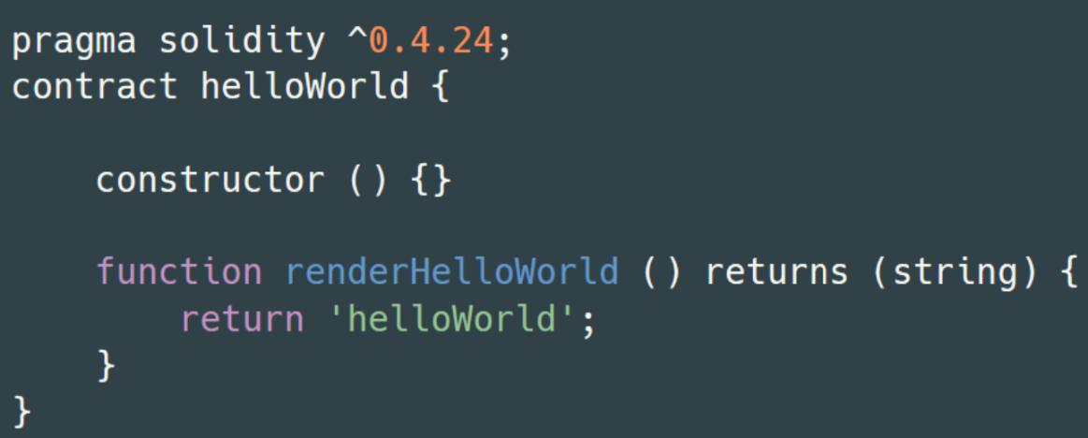
Brief Insight: Solidity
Solidity is a high-level language with a JavaScript-like syntax for
writing Ethereum smart contracts.
Language properties:
Statically typed
Object-oriented
Supports inheritance
Public & private methods
Dynamic binding
Compiles to EVM opcode instructions
U. Gallersdörfer, P. Holl, and F. Matthes, “Blockchain-based Systems Engineering – Lecture Slides,” Oct 2019. [Online]. Available: https://github.com/sebischair/bbse

Slide 43

Solidity to Smart Contract
Solidity code is stored in files with the special file extension .sol
A good practice is to have one separate .sol file per contract
The Solidity compiler takes a .sol file as input and generates the corresponding sequence of EVM opcode instructions
The opcode instructions are then encoded as hex bytecode
The contract is deployed via a special transaction containing the bytecode as payload
Once the transaction is mined, a new contract account on the Ethereum network is created
The contract is now usable
U. Gallersdörfer, P. Holl, and F. Matthes, “Blockchain-based Systems Engineering – Lecture Slides,” Oct 2019. [Online]. Available: https://github.com/sebischair/bbse

Slide 44
Ethereum Decentralized Applications

Slide 45
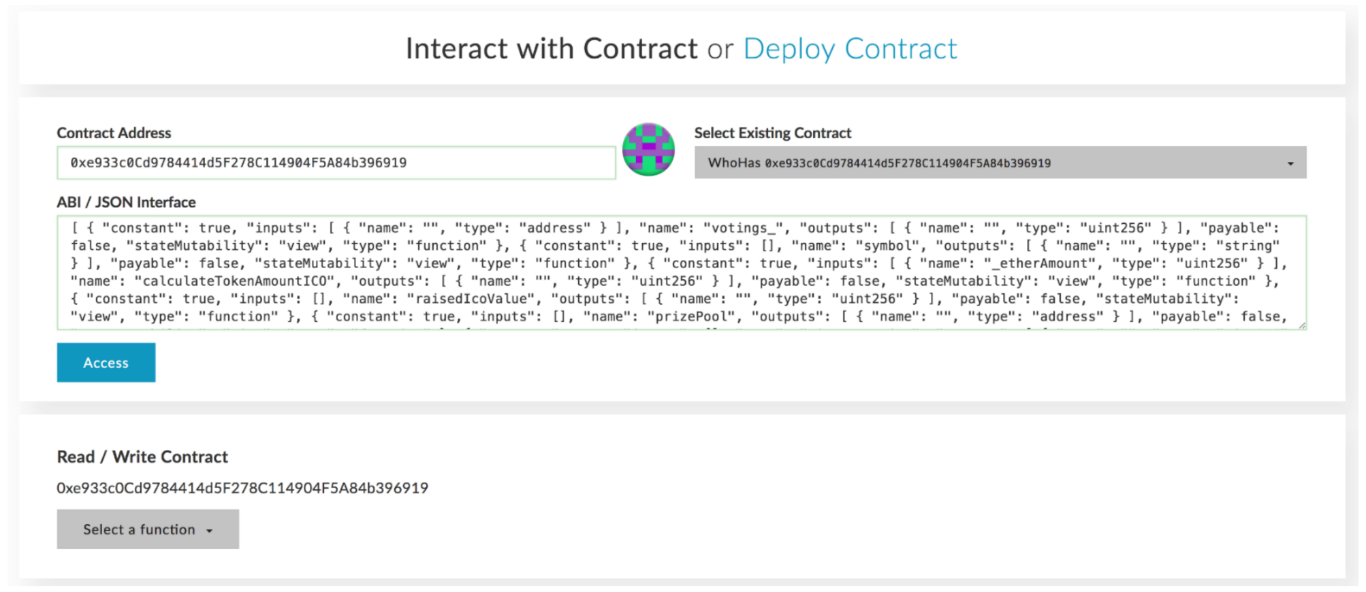
Motivation
Direct interaction with smart contracts is complicated
Smart contracts do not provide a graphical user interface on their own
Programming knowledge or special tools are required to make function calls
U. Gallersdörfer, P. Holl, and F. Matthes, “Blockchain-based Systems Engineering – Lecture Slides,” Oct 2019. [Online]. Available: https://github.com/sebischair/bbse

Slide 46
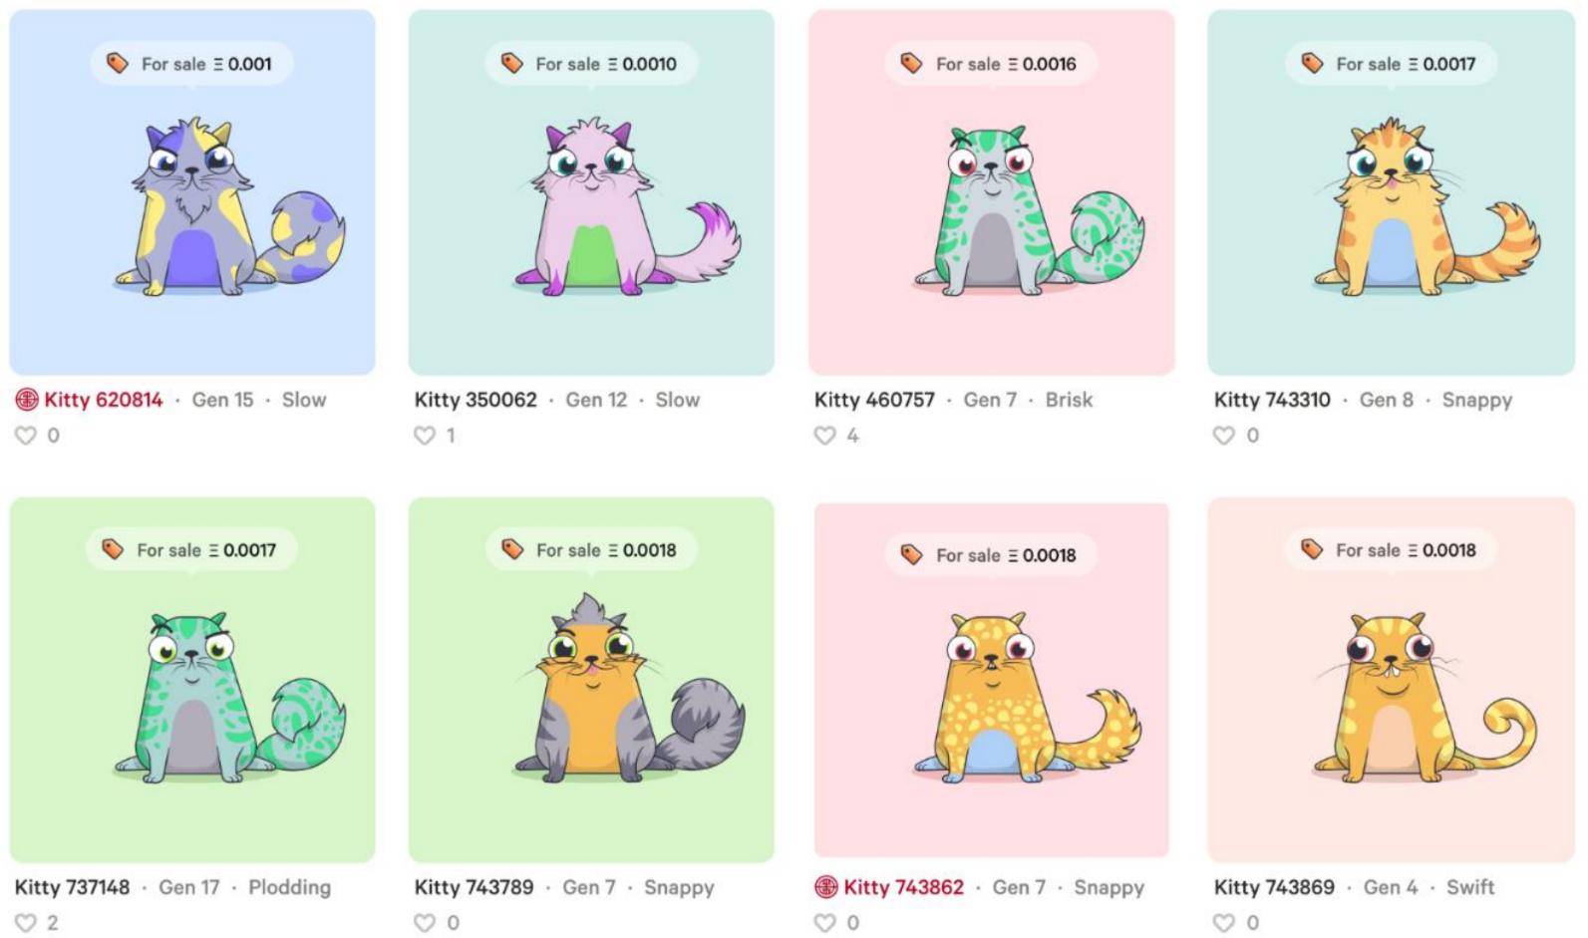
Motivation
Building UIs on top of smart contracts to make them accessible to average users
The UI abstracts the complicated function calls and allows a user to interact with them just like with a regular (web) application
U. Gallersdörfer, P. Holl, and F. Matthes, “Blockchain-based Systems Engineering – Lecture Slides,” Oct 2019. [Online]. Available: https://github.com/sebischair/bbse

Slide 47
Definition
In the community, multiple definitions for dApps exist
In general, a dApp is not necessarily based on a Blockchain, e.g., BitTorrent is a decentralized P2P application without any blockchain involved
In this lecture, we consider a dApp as a decentralized application (in the terms of blockchain) based on one or more smart contracts and accessible via a dedicated user interface
In particular, the following properties must hold:
The core data records of the application must be stored on the blockchain
The functions that change the core data records must be executed on the blockchain, i.e. via a smart contract

Slide 48
Benefits
The meaningfulness of implementing a distributed application is dependent on the concrete use case and / or the problem that is being solved.
Some general properties of Ethereum-based dApps:
Trust
The source code of any verified smart contract can be checked by anyone.
Payment
Payment is implemented by default since anyone can send / receive Ether.
Accounts
dApps can be build on top of Ethereum’s account system, so there is no need to implement an additional user account management system.
Storage
dApps can leverage the Blockchain as common (expensive) data storage.

Slide 49
Drawbacks
Decentralized applications have also some intrinsic disadvantages:
Costs
Any state change and computation costs money. For that reason, only mission-critical data and functionality should leverage the blockchain.
Time
The current block time of Ethereum is around 14 seconds, i.e., it takes at least 14 seconds from the function call to the definite result of it.
Availability
In theory, availability is one of the key advantages of dApps. However, in high transaction scenarios (e.g. the release of crypto kitties) it is possible that the network throttles and is not able to process function calls anymore.
Transparency
Without third party services, it is impossible to access and verify a Smart Contract source code.

Slide 50
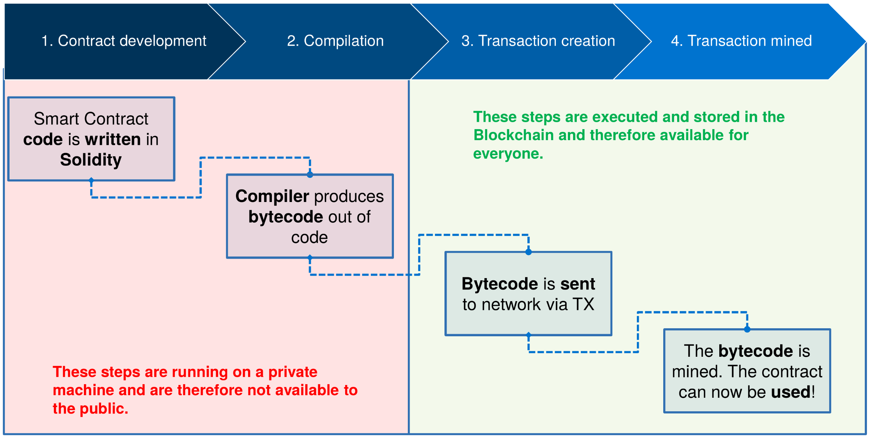
Recap – Deploy Smart Contract on Chain
U. Gallersdörfer, P. Holl, and F. Matthes, “Blockchain-based Systems Engineering – Lecture Slides,” Oct 2019. [Online]. Available: https://github.com/sebischair/bbse

Slide 51
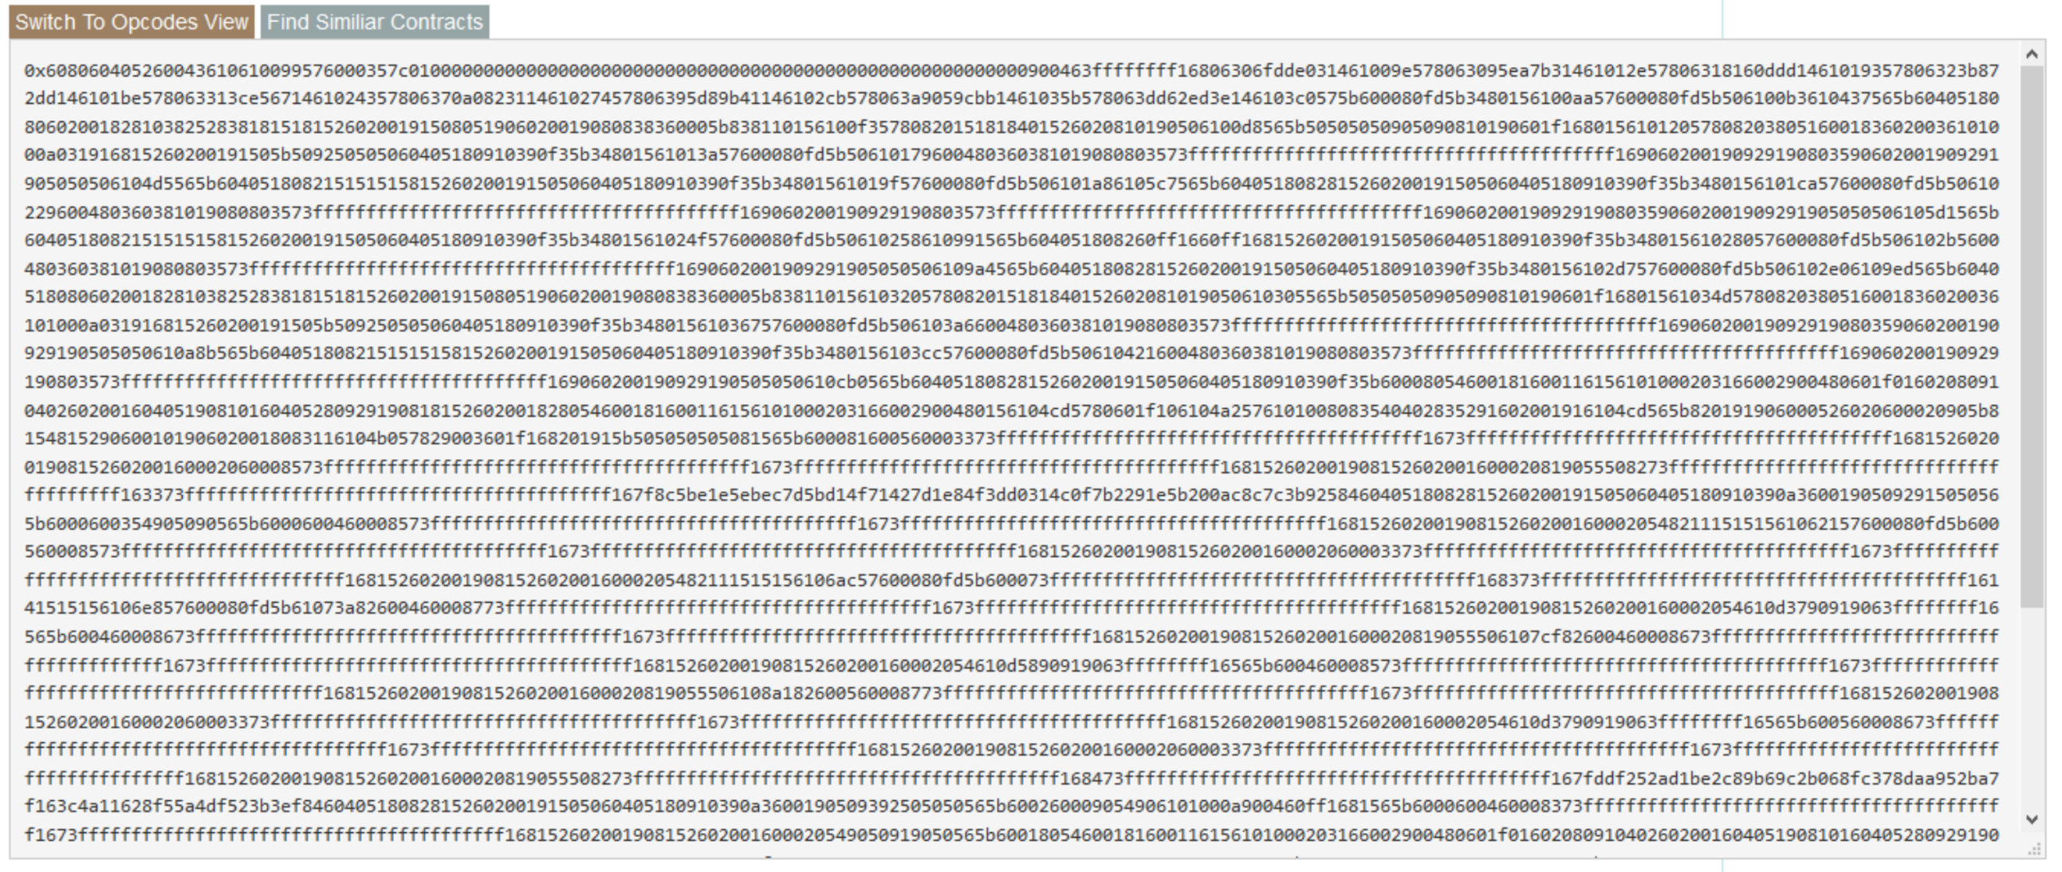
Bytecode Source Code on Chain
U. Gallersdörfer, P. Holl, and F. Matthes, “Blockchain-based Systems Engineering – Lecture Slides,” Oct 2019. [Online]. Available: https://github.com/sebischair/bbse

Slide 52
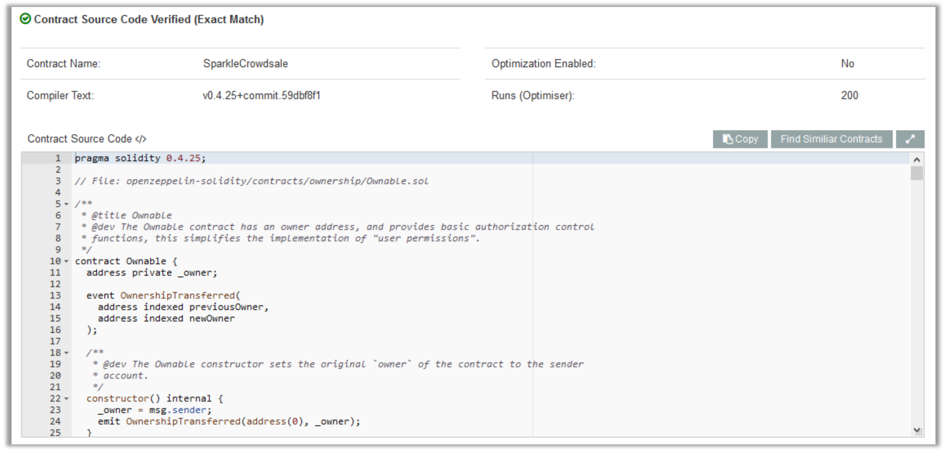
Publicly Available Source Code
Etherscan.io is a service which also verifies source codes and the respective byte code.
U. Gallersdörfer, P. Holl, and F. Matthes, “Blockchain-based Systems Engineering – Lecture Slides,” Oct 2019. [Online]. Available: https://github.com/sebischair/bbse

Slide 53
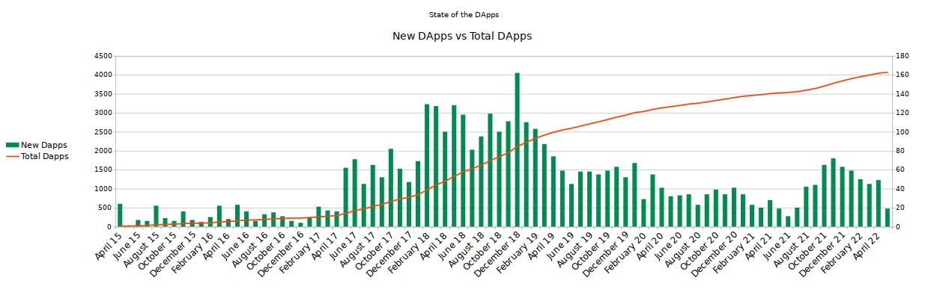
Web-based Ethereum dApps
State of the Dapps (Link) is a curated and community-driven directory of decentralized applications.
As of May 2022, the directory lists 4073 DApps (2970 Ethereum DApps).
Graph recreated based on data from https://www.stateofthedapps.com/stats

Slide 54
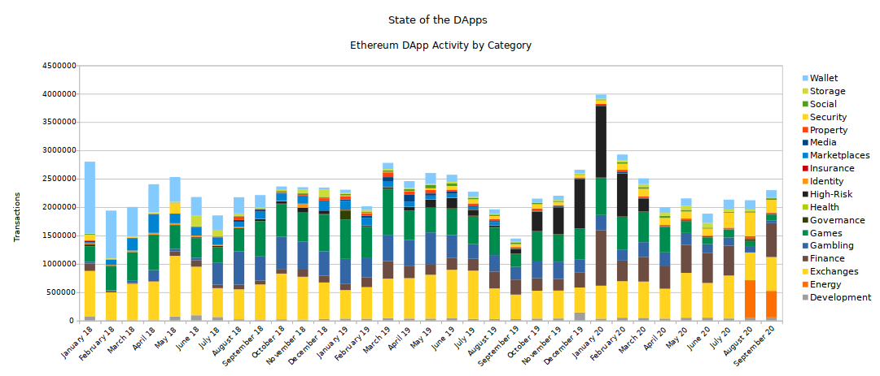
dApps Statistics – Transactions per dApp
Graph recreated based on data from https://www.stateofthedapps.com/stats

Slide 55
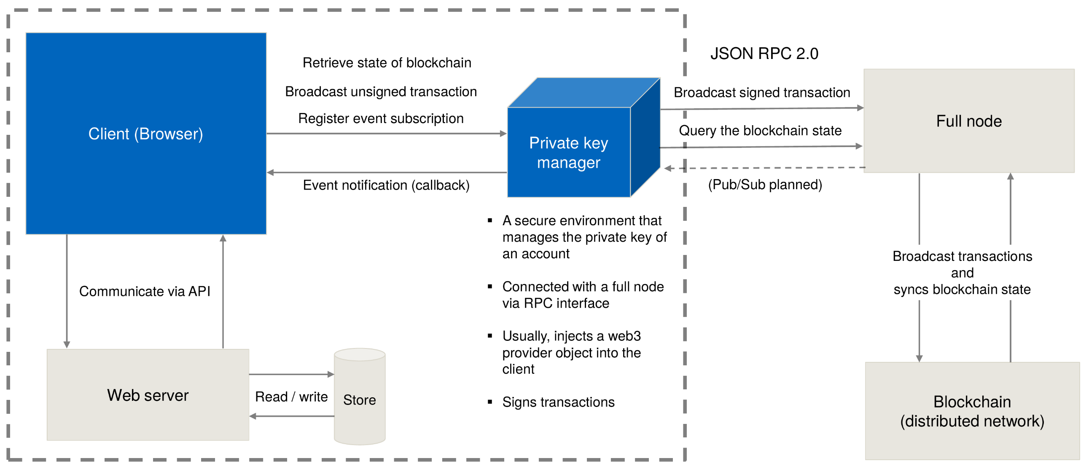
Architecture of Web-based dApps
U. Gallersdörfer, P. Holl, and F. Matthes, “Blockchain-based Systems Engineering – Lecture Slides,” Oct 2019. [Online]. Available: https://github.com/sebischair/bbse

Slide 56
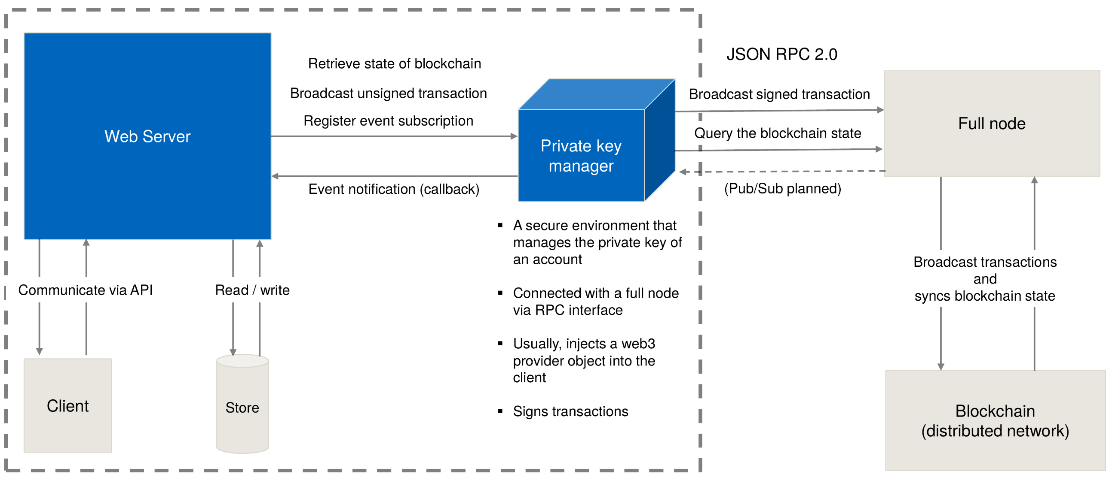
Architecture of Web-based dApps
U. Gallersdörfer, P. Holl, and F. Matthes, “Blockchain-based Systems Engineering – Lecture Slides,” Oct 2019. [Online]. Available: https://github.com/sebischair/bbse

Slide 57
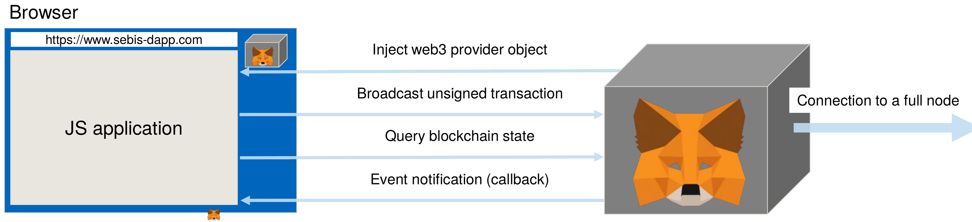
Metamask
U. Gallersdörfer, P. Holl, and F. Matthes, “Blockchain-based Systems Engineering – Lecture Slides,” Oct 2019. [Online]. Available: https://github.com/sebischair/bbse

Slide 58
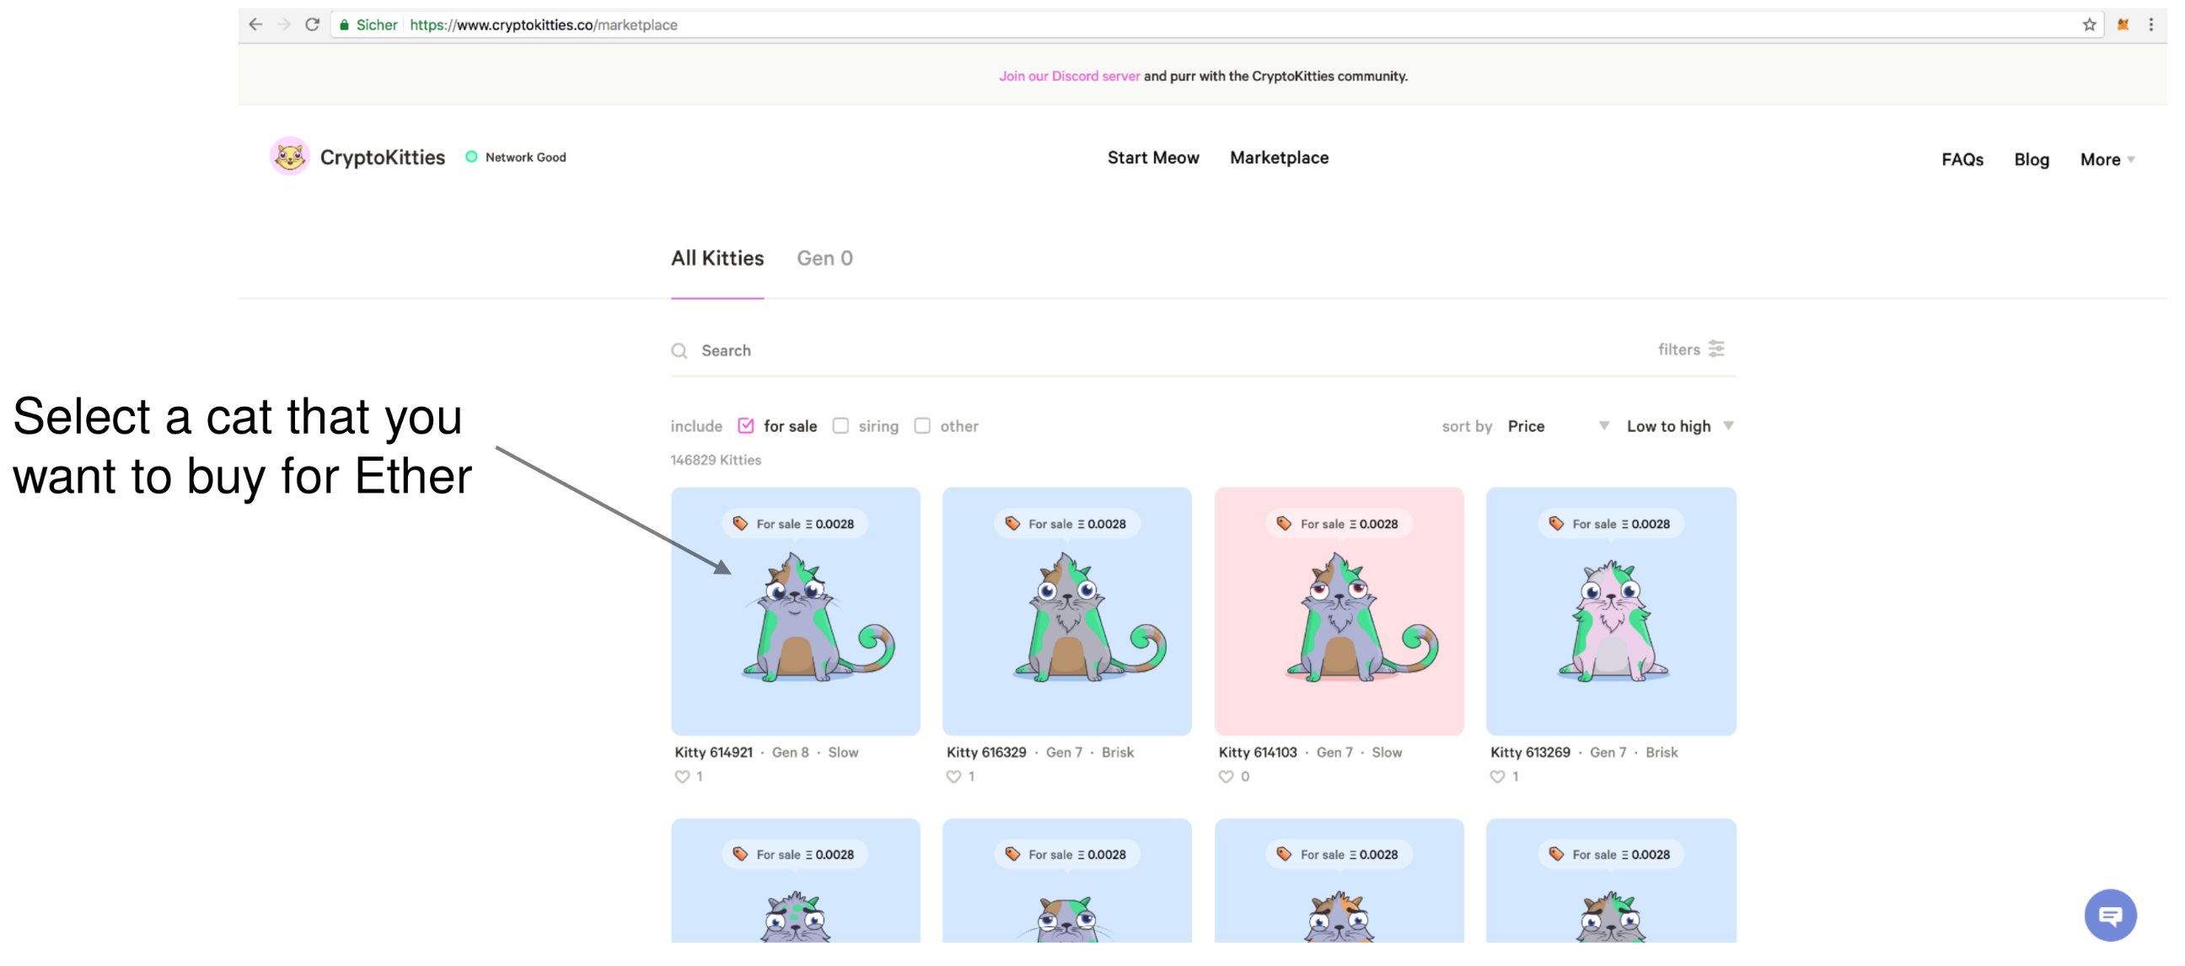
Example: CryptoKitties
U. Gallersdörfer, P. Holl, and F. Matthes, “Blockchain-based Systems Engineering – Lecture Slides,” Oct 2019. [Online]. Available: https://github.com/sebischair/bbse

Slide 59
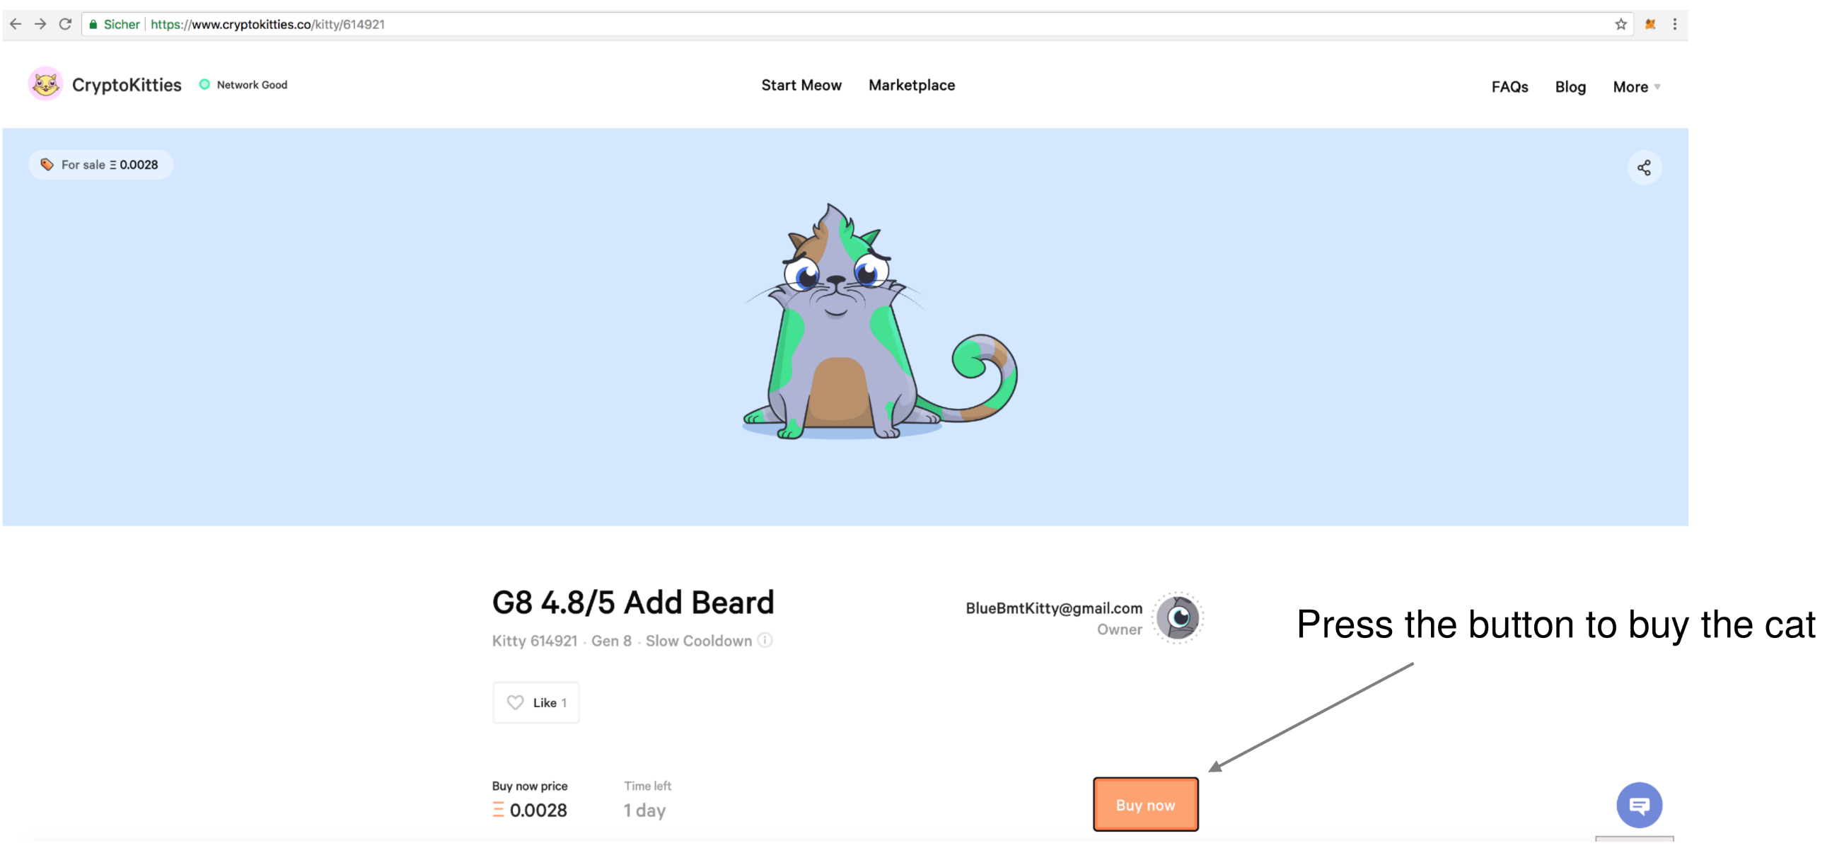
Example: CryptoKitties
U. Gallersdörfer, P. Holl, and F. Matthes, “Blockchain-based Systems Engineering – Lecture Slides,” Oct 2019. [Online]. Available: https://github.com/sebischair/bbse

Slide 60
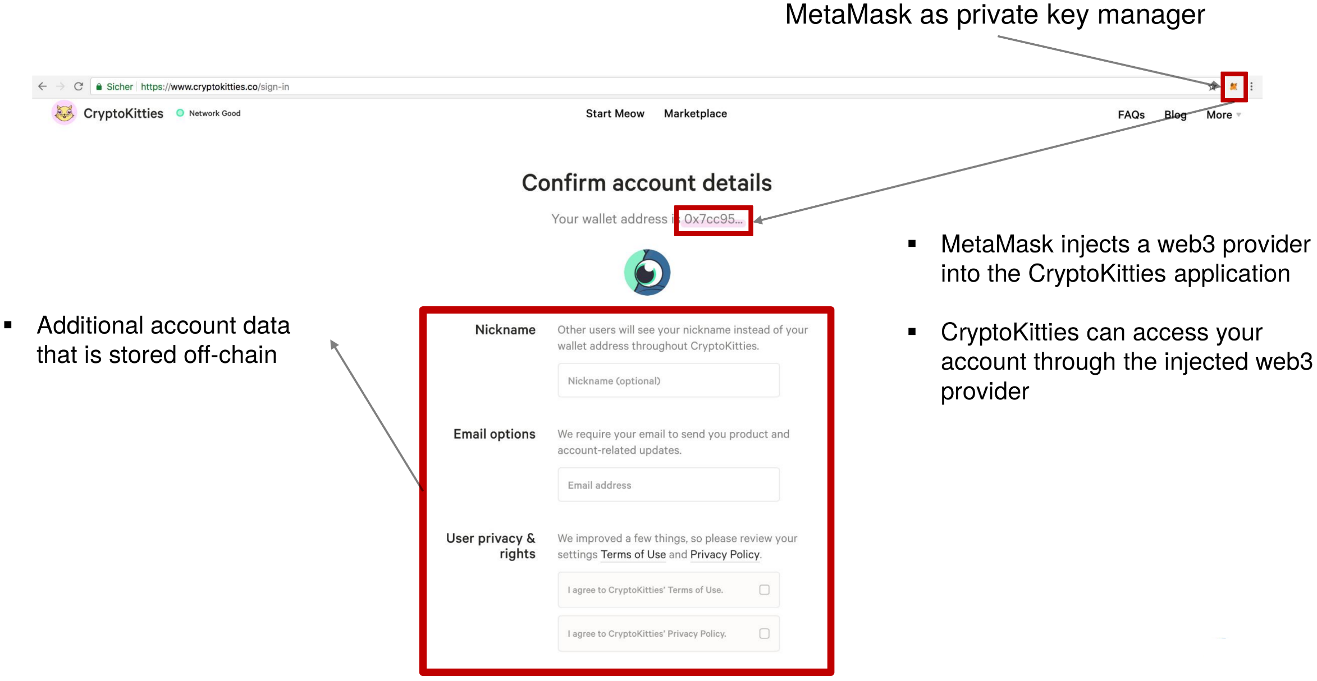
Example: CryptoKitties
U. Gallersdörfer, P. Holl, and F. Matthes, “Blockchain-based Systems Engineering – Lecture Slides,” Oct 2019. [Online]. Available: https://github.com/sebischair/bbse

Slide 61
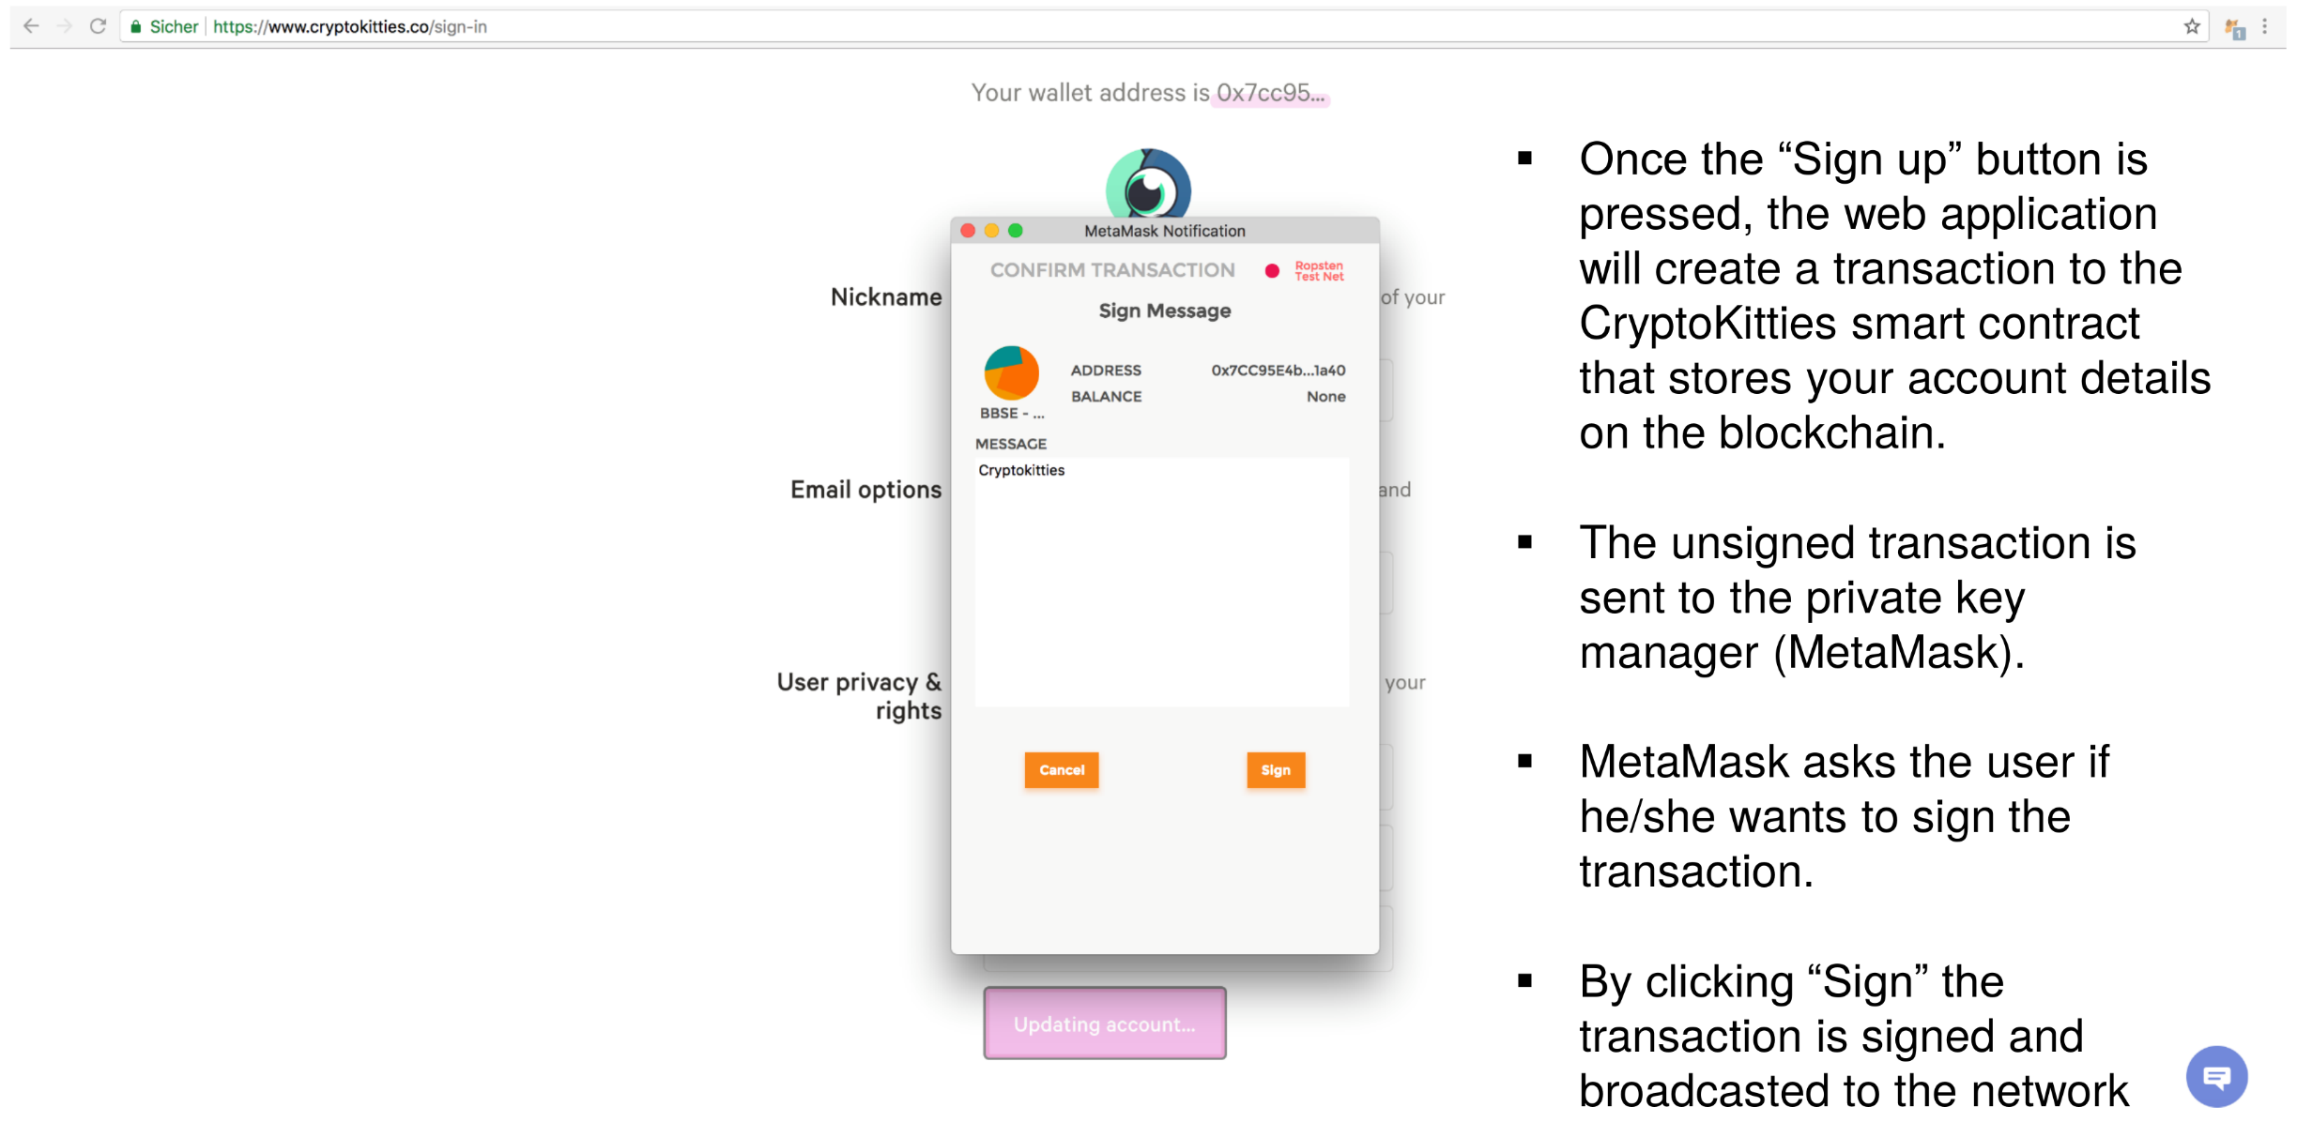
Example: CryptoKitties
U. Gallersdörfer, P. Holl, and F. Matthes, “Blockchain-based Systems Engineering – Lecture Slides,” Oct 2019. [Online]. Available: https://github.com/sebischair/bbse

Slide 62
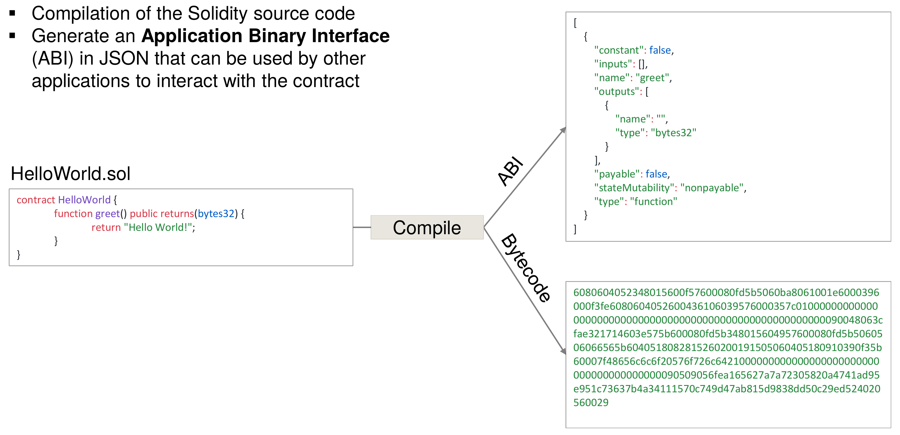
Deployment Lifecycle
U. Gallersdörfer, P. Holl, and F. Matthes, “Blockchain-based Systems Engineering – Lecture Slides,” Oct 2019. [Online]. Available: https://github.com/sebischair/bbse

Slide 63
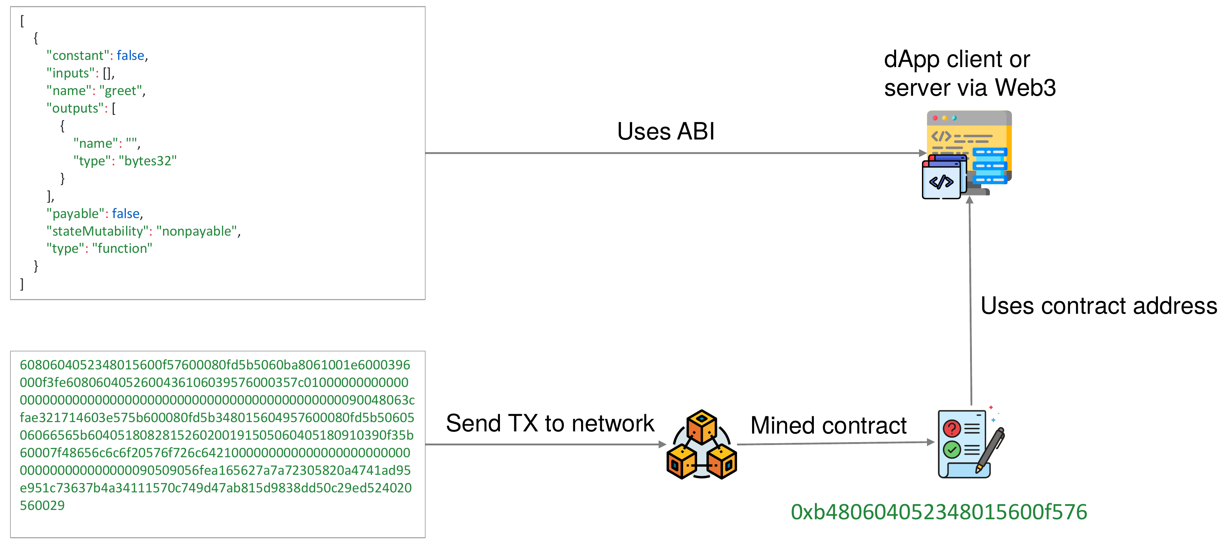
Deployment Lifecycle
U. Gallersdörfer, P. Holl, and F. Matthes, “Blockchain-based Systems Engineering – Lecture Slides,” Oct 2019. [Online]. Available: https://github.com/sebischair/bbse

Slide 64
Oracles
Smart contracts cannot access any data from outside the blockchain on their own → on purpose to prevent non-deterministic behavior
Also no functions to generate random values
Solution → Oracles
3rd-party services that verify data from web services and write the data via a smart contract to the chain

Slide 65
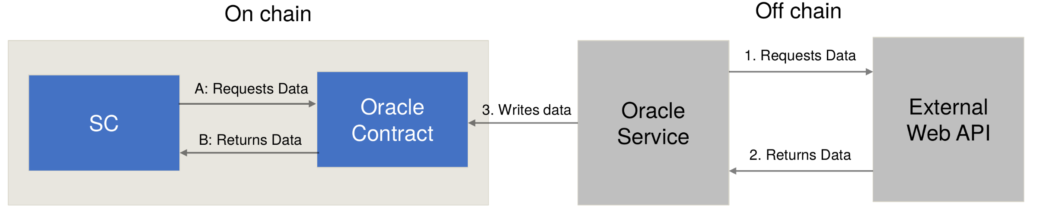
Oracles
Smart contracts cannot access any data from outside the blockchain on their own → on purpose to prevent non-deterministic behavior
Also no functions to generate random values
Solution → Oracles
3rd-party services that verify data from web services and write the data via a smart contract to the chain
U. Gallersdörfer, P. Holl, and F. Matthes, “Blockchain-based Systems Engineering – Lecture Slides,” Oct 2019. [Online]. Available: https://github.com/sebischair/bbse

Slide 66
Ethereum Development Tools

Slide 67
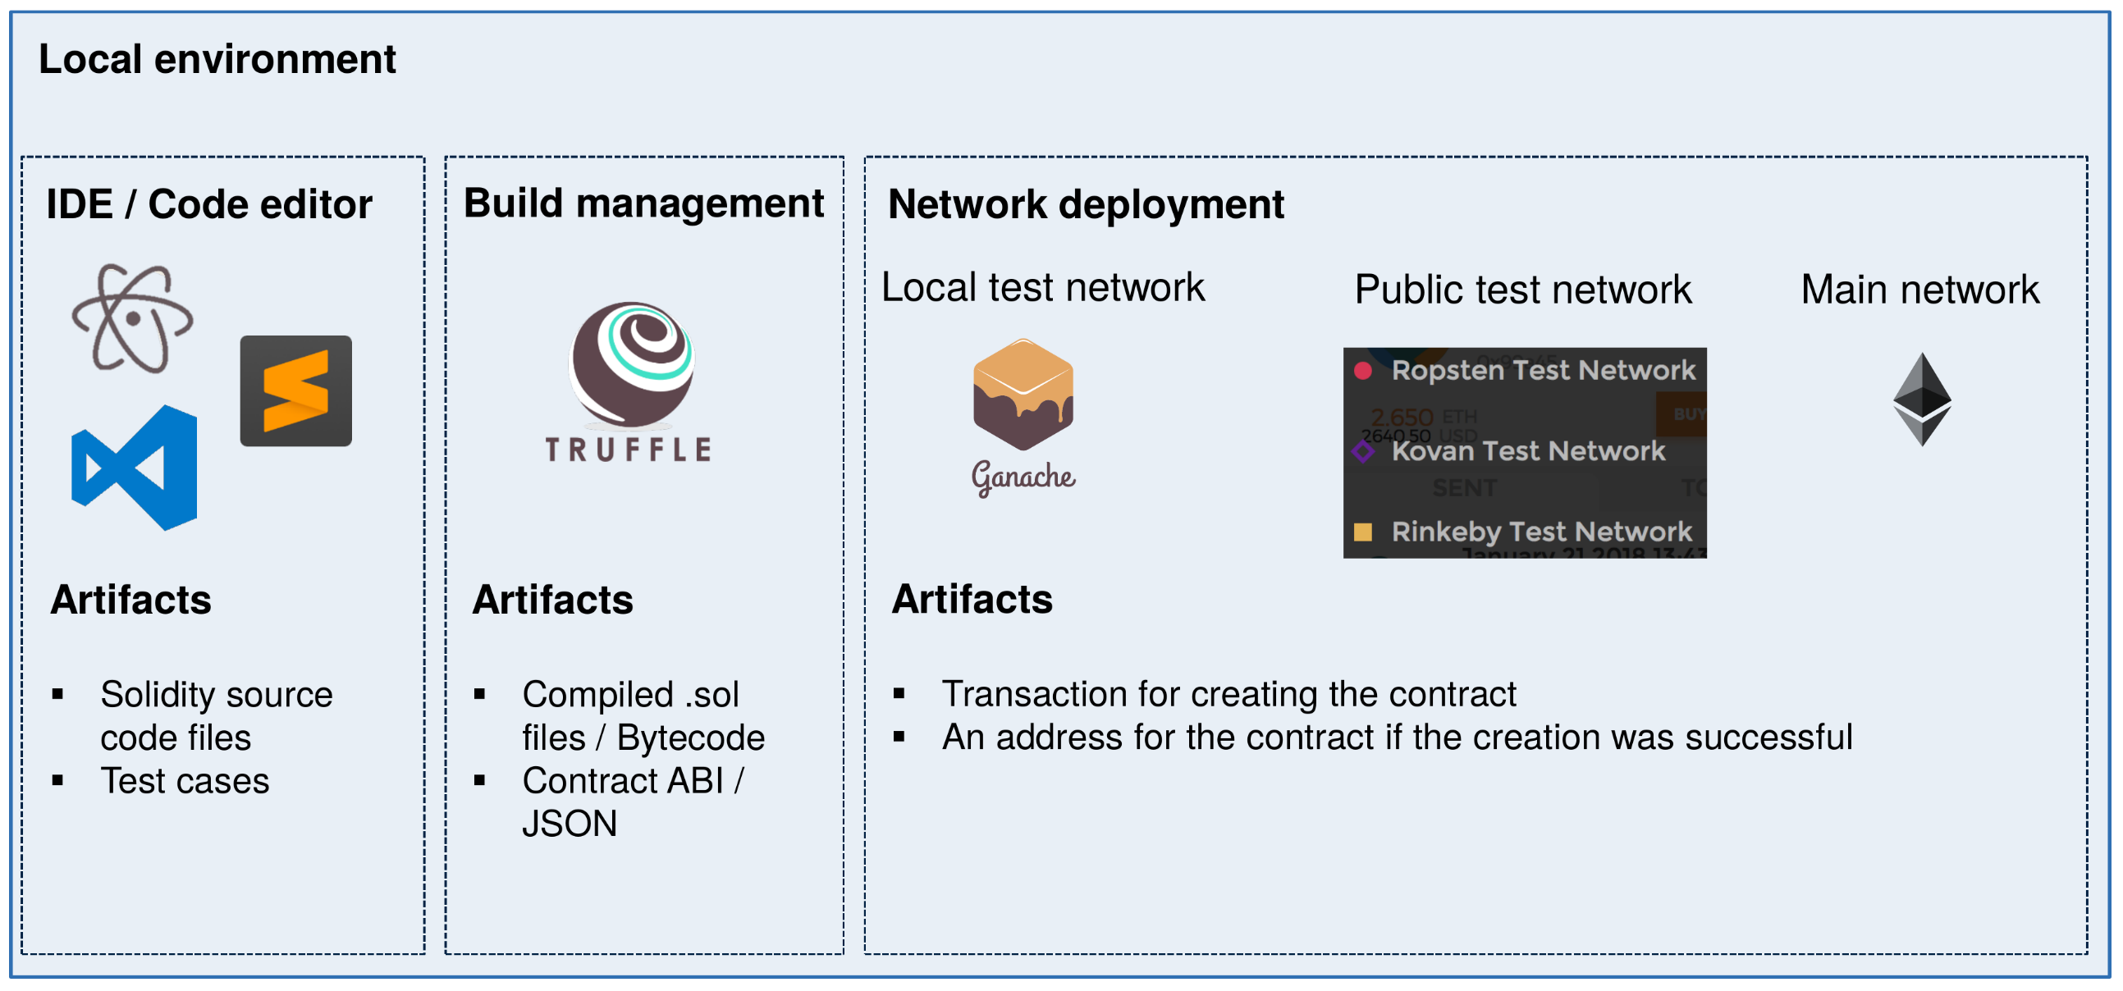
Development Tools
U. Gallersdörfer, P. Holl, and F. Matthes, “Blockchain-based Systems Engineering – Lecture Slides,” Oct 2019. [Online]. Available: https://github.com/sebischair/bbse

Slide 68

Truffle – Development Framework for Smart Contracts
Truffle is a popular framework to facilitate the development of Ethereum smart contracts. It provides tools to compile, test and deploy Solidity contracts.
Open source – Github
Built-in network management that allows a developer to deploy a smart contract on various networks, e.g., live and test
Web-pack like automated re-compilation on code change
Provides project scaffolding

Slide 69

Ganache – Private Ethereum Test Network
Ganache is a local blockchain for Ethereum smart contract development. It can be used to deploy, simulate, and test smart contracts.
Open source – Github
Integrates a custom block explorer interface with additional
debugging features.
Uses workspaces to provide multiple Ethereum blockchains
with different settings (blocktime etc.)
Can be linked to Truffle projects to automate tests for smart
contracts

Slide 70
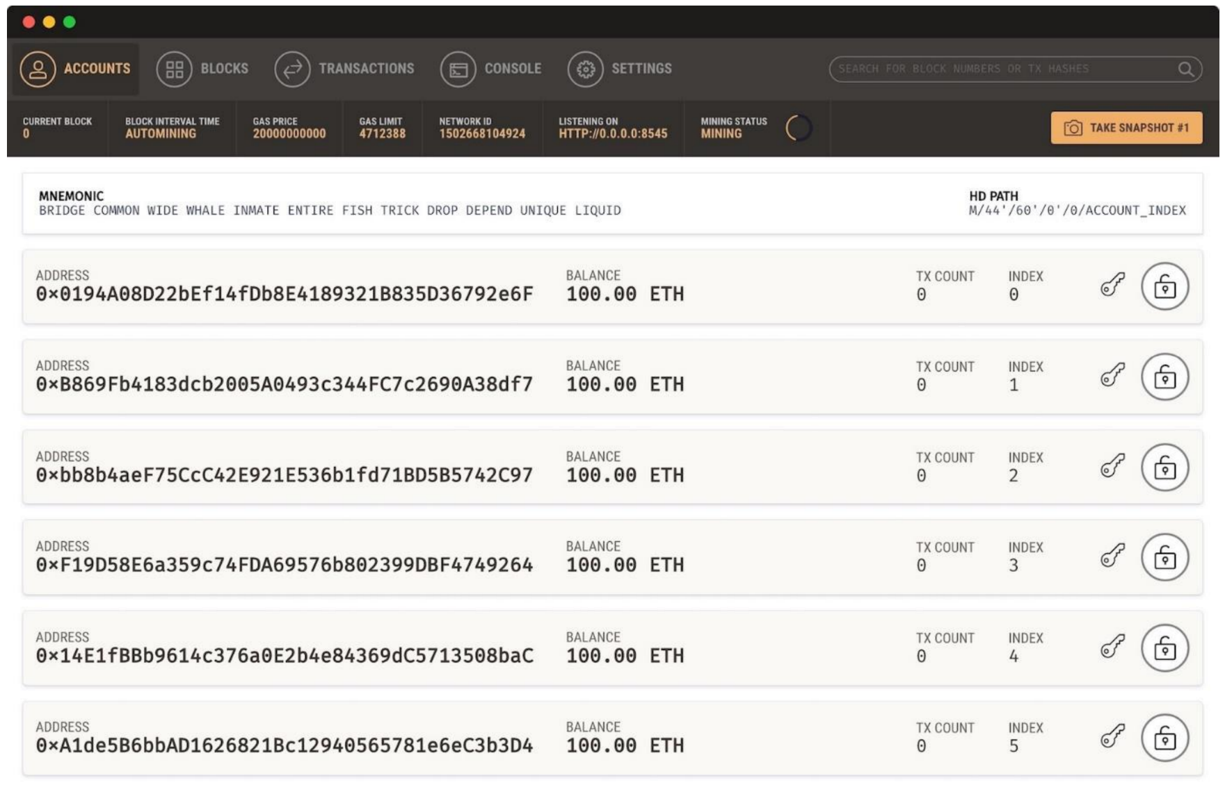
Ganache – Private Ethereum Test Network
Ganache ships with a ready-made and developer friendly block explorer:
U. Gallersdörfer, P. Holl, and F. Matthes, “Blockchain-based Systems Engineering – Lecture Slides,” Oct 2019. [Online]. Available: https://github.com/sebischair/bbse

Slide 71
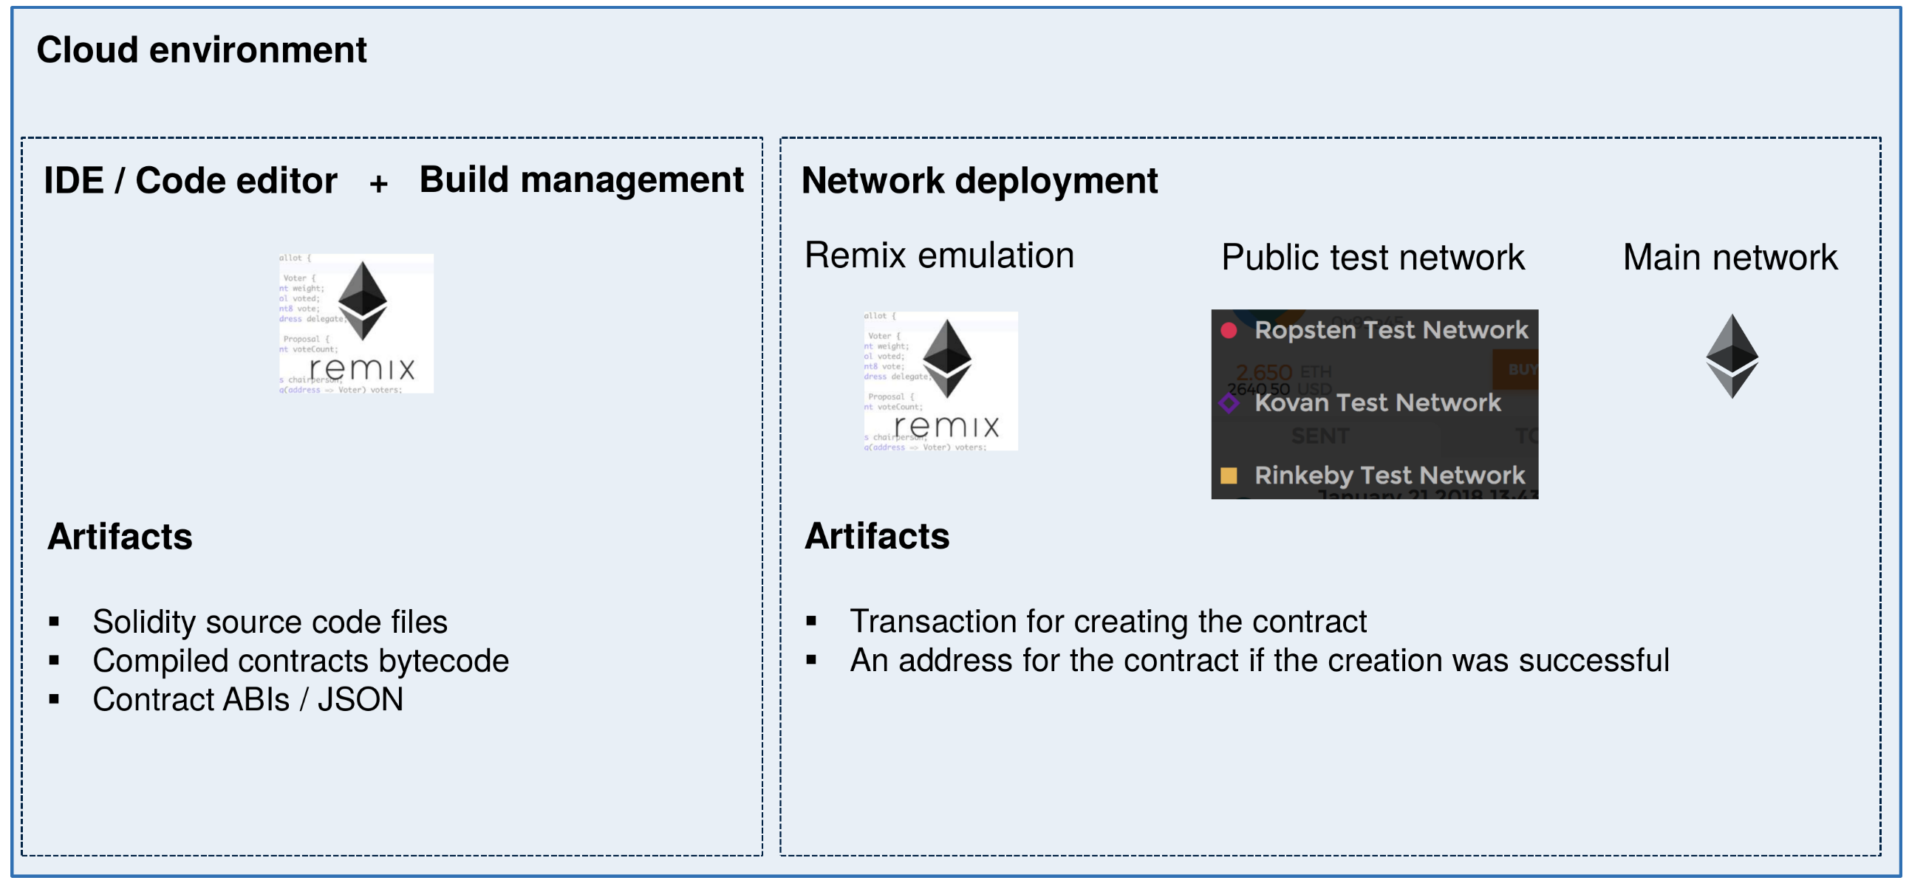
Development Tools
U. Gallersdörfer, P. Holl, and F. Matthes, “Blockchain-based Systems Engineering – Lecture Slides,” Oct 2019. [Online]. Available: https://github.com/sebischair/bbse

Slide 72
Remix IDE
Demo in Excercise Session

Slide 73
Test Networks – Ropsten
Free to use
Public
Block time of ca. 30s
Proof-of-Work consensus
Geth and Parity compatibility
Ether distribution via faucet – Link
Anonymous

Slide 74
Test Networks – Rinkeby
Free to use
Public
Block time of ca. 15s
Proof-of-Authority consensus, i.e., one central instance decides what transaction will be mined.
Geth only
Ether distribution via faucet – Link
Twitter or Facebook account required (Spam/DoS protection)

Slide 75
Test Networks – Kovan
Free to use
Public
Block time of ca. 4s
Proof-of-authority consensus, i.e., one central instance decides what transaction will be mined.
Parity only
Ether distribution via faucet – Link
Github account required (Spam/DoS protection)

Slide 76
Questions?

